Slide 1

Unlocking your full potential: from results to impact!
Dr Alessia Melasecche Germini, Booster Coordinator

Slide 2


Who can apply?
Horizon Europe
Horizon 2020
Ongoing or closed
projects
Direct or indirect
funding
Framework Programme 7​
Others: Joint Undertakings, Partnerships, EIT KICs…

Slide 3




Who can apply?
Single
organisation
One project
Group of organisations
Group of
projects

Slide 4
Collaborative & Support-Driven Learning Experience

Slide 5







Booster services: overview
Core Services
Dissemination
Support
Go-To-Market
Support
Add-On Services
Networking
Portfolio
Analysis
Intellectual Assets
Management
Coaching for
Public Speaking
Audio-Visual
Support

Slide 6



Booster in numbers
>200
>2.000
>3.000
Experts who delivered services
Projects supported with expertise and training
Services requested since Booster's launch

Slide 7

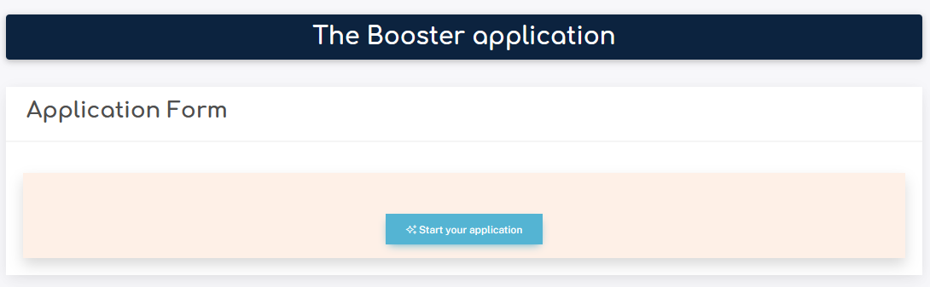

How to apply?
www.horizonresultsbooster.eu

Slide 8

Next steps
Application submitted
Approval by the European Commission (7-10 days)
Mentors appointed (7-10 days)
Service roadmap agreed
Service delivery begins (from the next month)

Slide 9
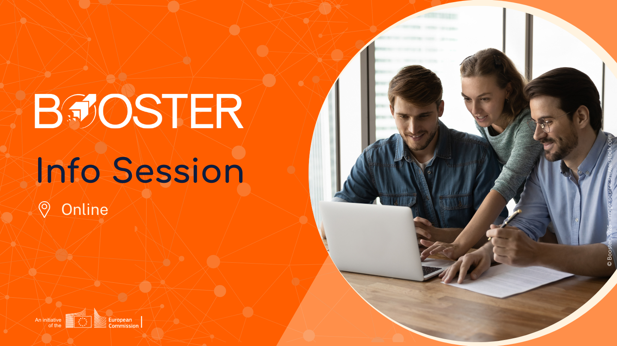
Upcoming Booster Info Sessions 2025
Wednesday, 18 June
Wednesday, 24 September
Wednesday, 26 November
https://ec.europa.eu/research/participants/docs/h2020-funding-guide/other/event250618-2.htm
11:00 AM - 12:00 PM CEST
(all dates)

Slide 10




Dr Alessia Melasecche Germini
booster@meta-group.com
www.horizonresultsbooster.eu
Scan to subscribe to the Booster newsletter!
© Booster, 2025 - image sources: Canva, Unsplash, Pexels

