Slide 1
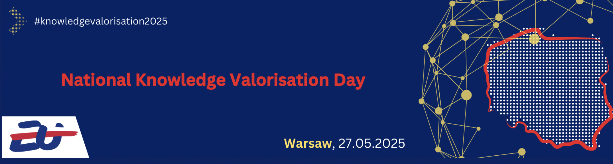
Skills and capacities for knowledge valorisation
Case studies
Antonio Carbone

Slide 2
The Draghi’s Report
“The links between higher education and business are weak and researchers have few incentives to become
entrepreneurship. There are several reasons why the links between higher education and business are weak,
including insufficient awareness of the potential benefits of collaboration and an insufficiently developed
management of intellectual property rights (IPR) and the commercialisation of research.
There are significant differences in the management of IPR across universities, including differences about
who legally owns IPR and whether universities can acquire stakes in spin-offs. In many cases, financial incentives for researchers are limited, as they cannot fully appropriate royalties from licencing IPR. Moreover, researchers’ assessments do not adequately reward multi-track careers, and dual university-industry appointments are uncommon”
The future of European competitiveness. Part B | In-depth analysis and recommendations. EC General Publication, 9 September 2024

Slide 3
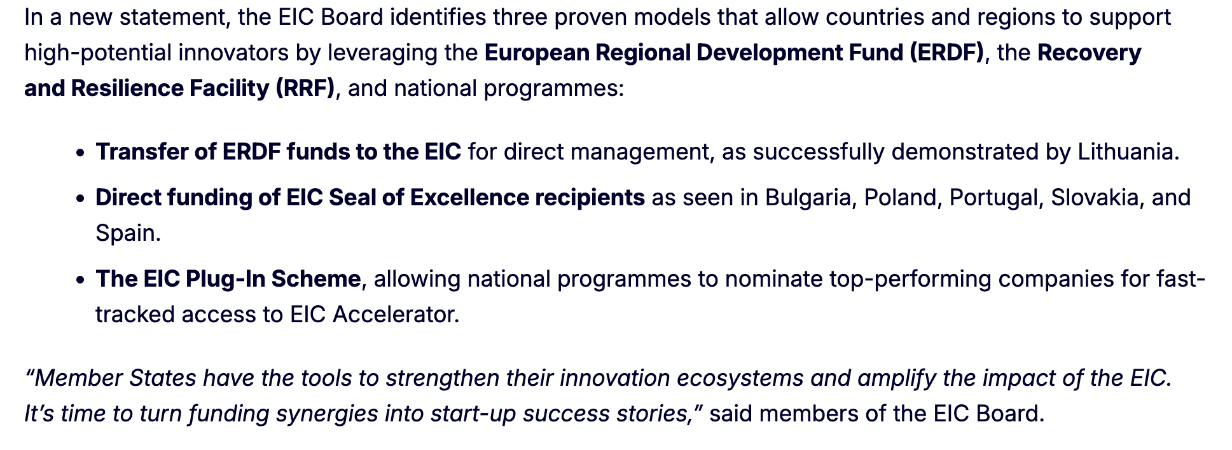
EIC Board statement
Statement
12 May 2025
EIC Board statement on synergies

Slide 4
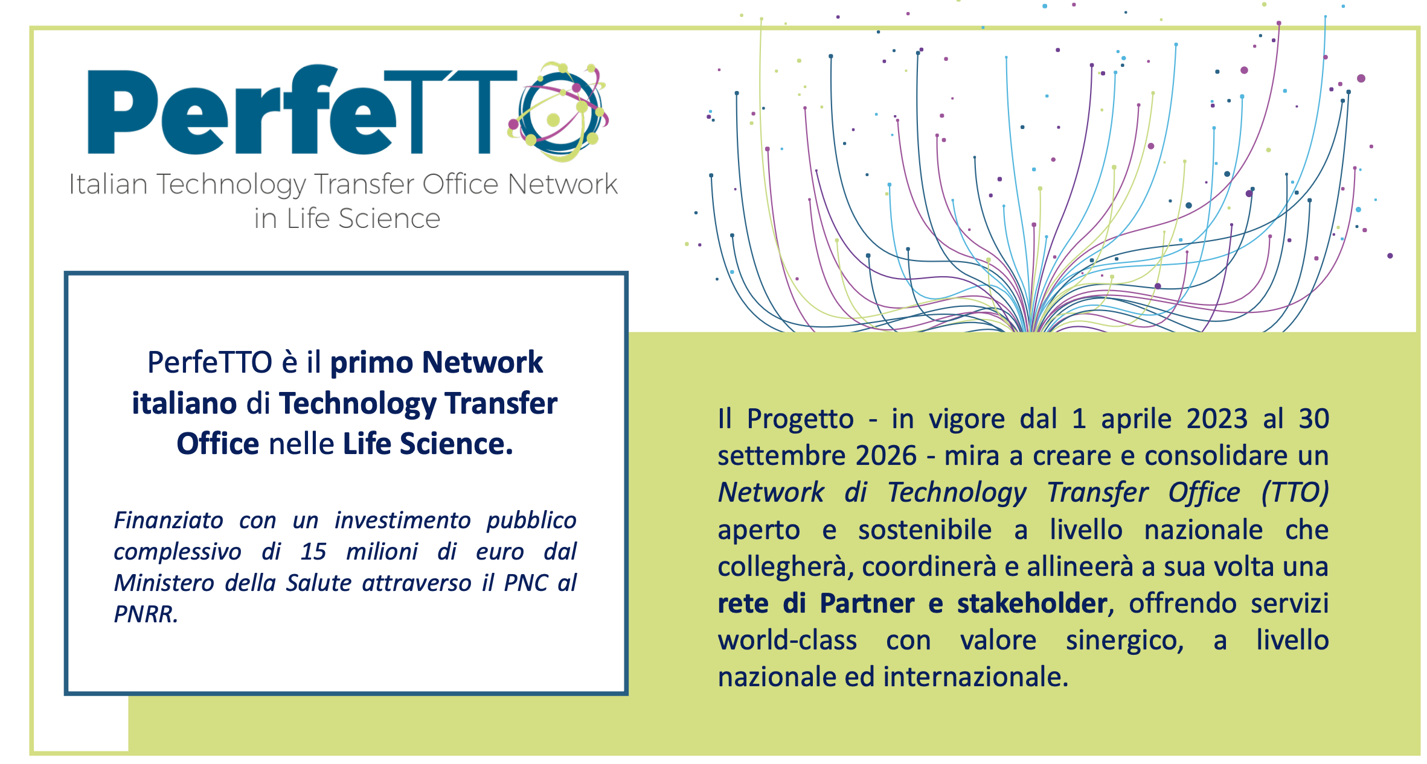
First Italian Network of
Life Sciences Knowledge and
Technology Transfer Offices
Funding of 15 millions € provided by the Italian Health Ministry through
the Next Generation Plan
The Project (April 2023 - September 2026) aims to create and consolidate an open and sustainable Network of Technology Transfer Offices (TTO) at national level that will connect, coordinate and align in turn a network of Partners and stakeholders, offering world-class services with synergic value, at national and international level.

Slide 5
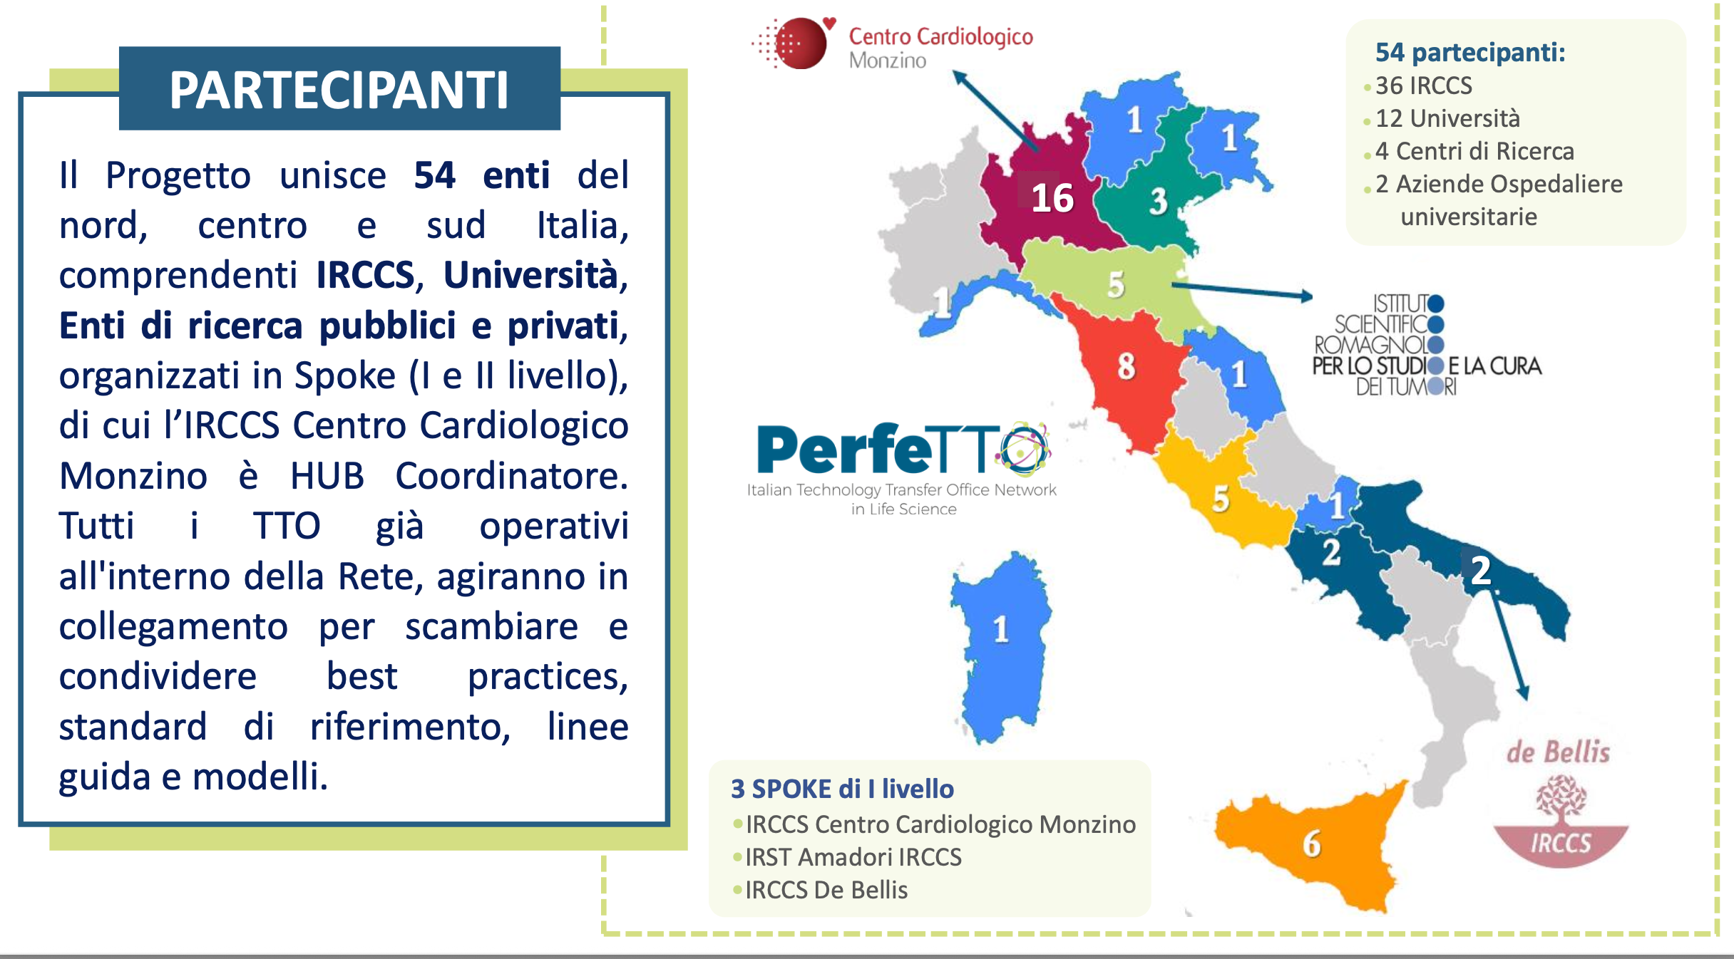
54 Participants
36 IRCCS
12 Universitites
4 Research Centers
2 University Hospital companies
PARTICIPANTS
The Project includes 54 entities from the North, Center and South of Italy, including IRCCS, Universities, public and private research institutions, organized in Spokes (I and II level), of which the IRCCS Centro Cardiologico Monzino is the Coordinating HUB. All the TTOs will act in connection to exchange and share best practices, reference standards, guidelines and models.

Slide 6
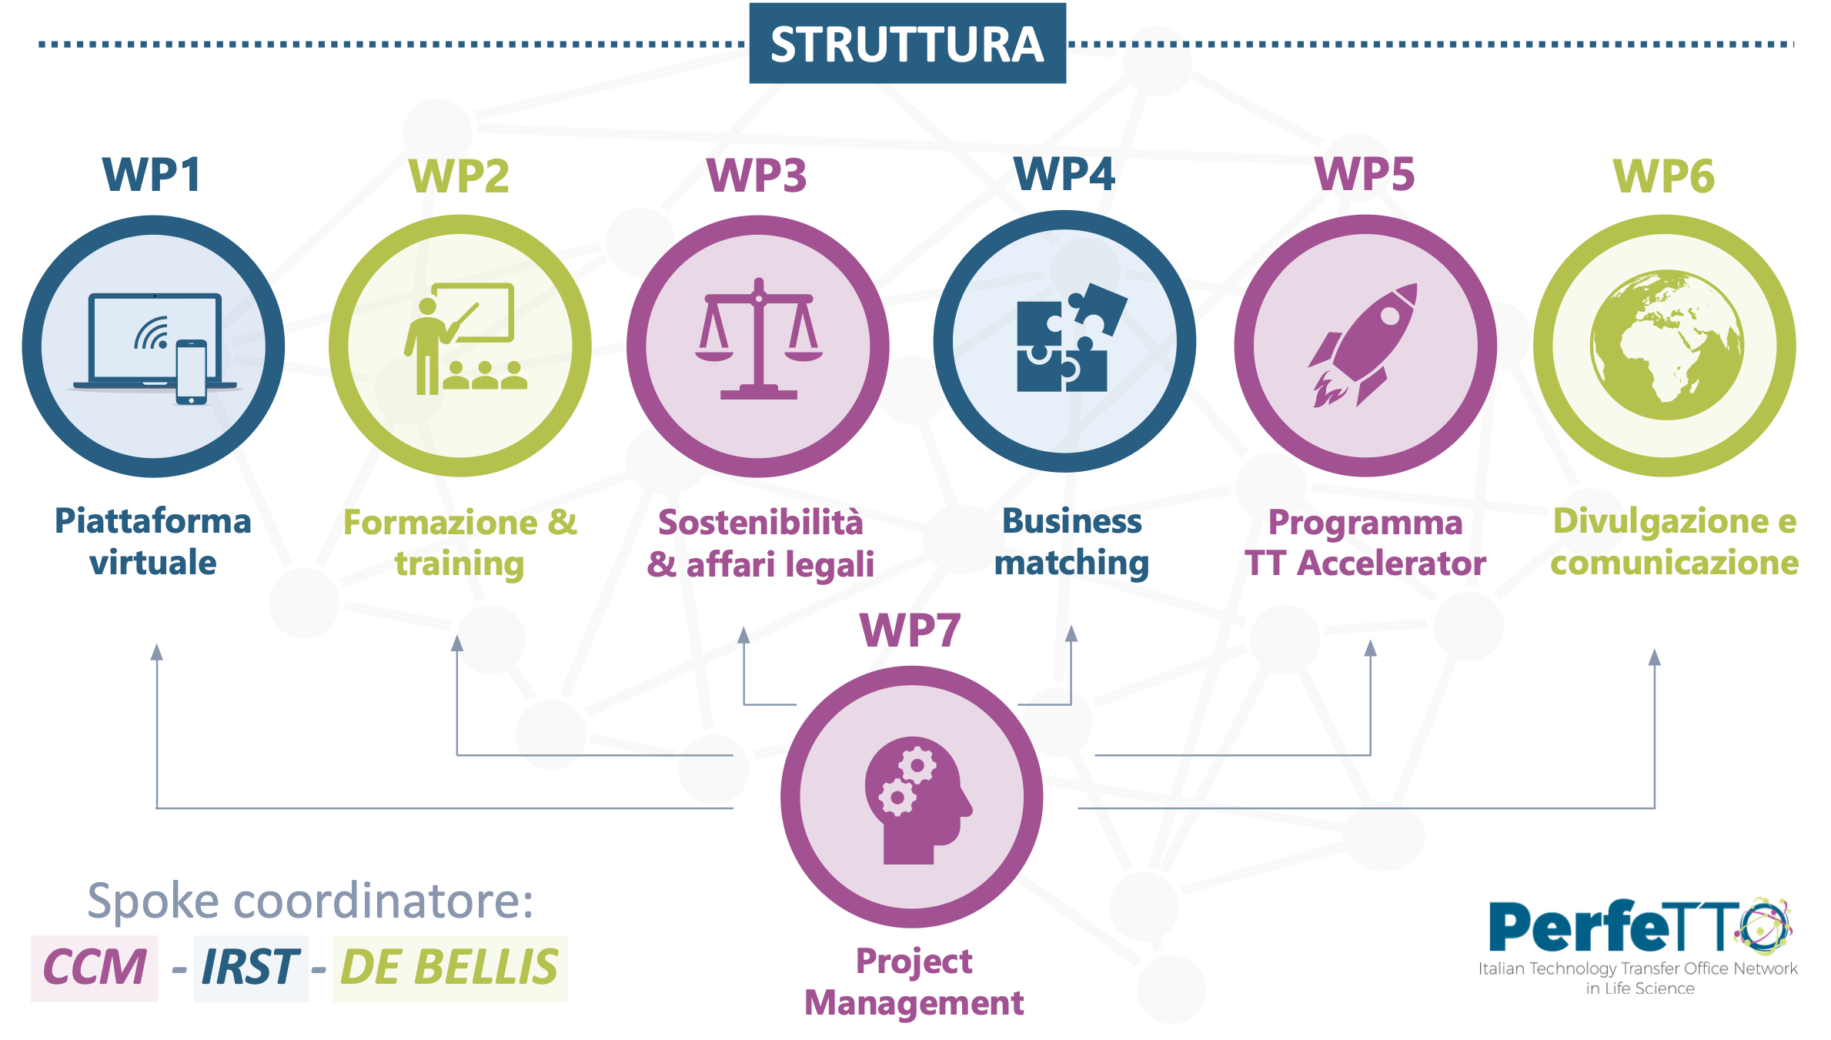
STRUCTURE
Virtual Platform
Training
Sustainability & Legal affairs
TT Accelerator
Programme
Dissemination & Communication
SPOKE COORDINATOR

Slide 7
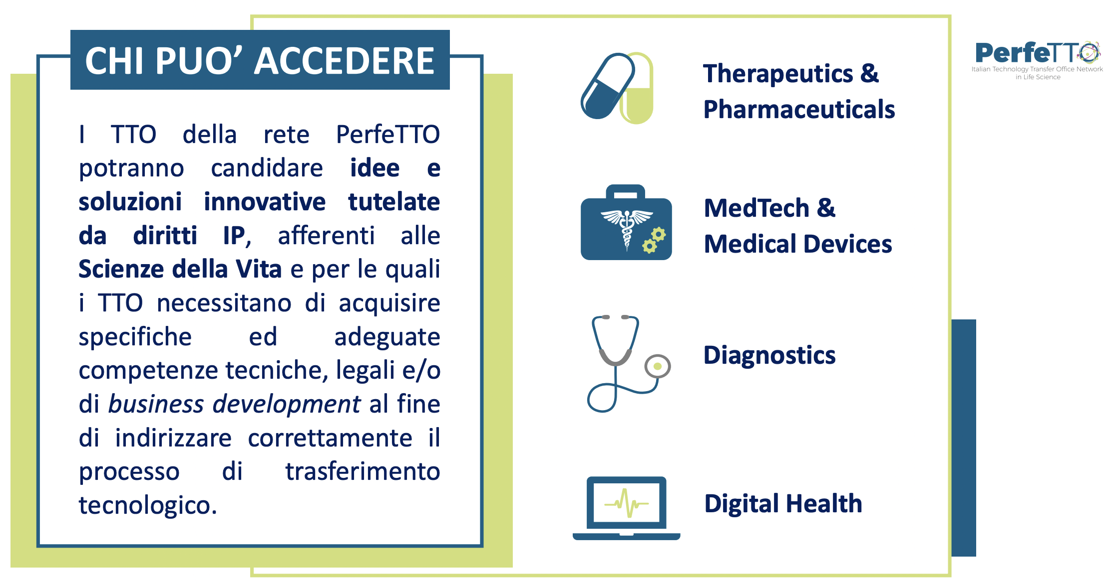
WP5 ACCELERATOR
The TTOs of the PerfeTTO network will be able to nominate innovative ideas and solutions protected by IP rights, related to Life Sciences and for which the TTOs need to acquire specific and adequate technical, legal and/or business development skills in order to correctly direct the technology transfer process.

Slide 8
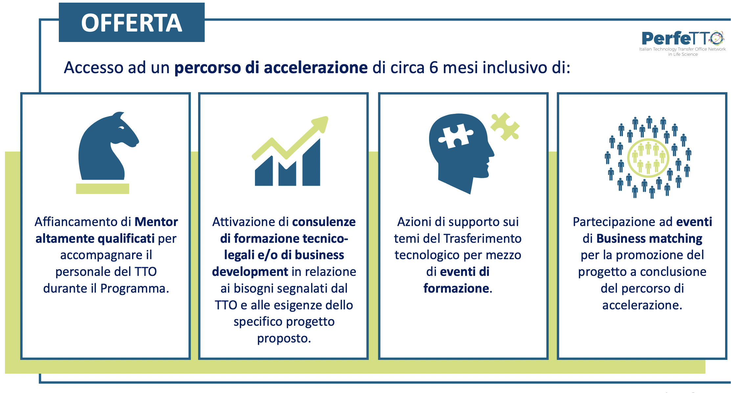
OFFER
6-MONTHS JOURNEY INCLUDING:
Activation of technical & legal training and/or business development consultancy in relation to the needs reported by the TTO and the needs of the specific project proposed.
Participation in Business matching events for the promotion of the project at the end of the acceleration process.
Support from highly qualified Mentors to accompany the TTO staff during the Program
Support actions on Technology Transfer topics through training events.

Slide 9
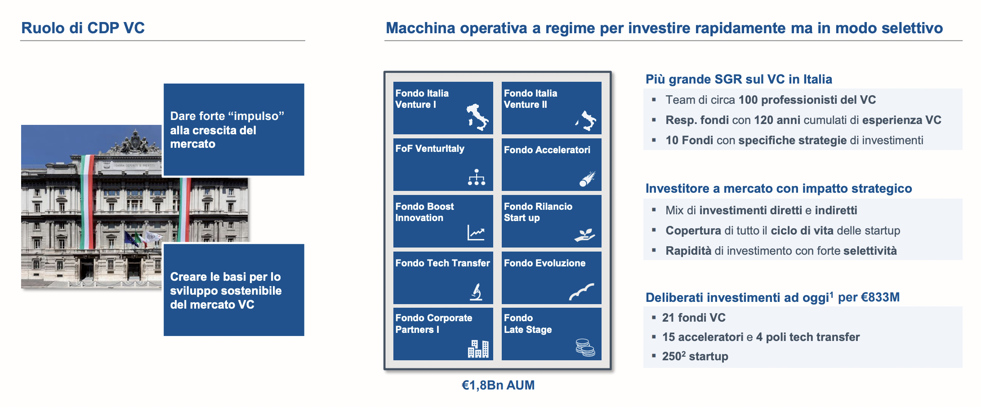
CDP VC plays a central role in the development of VC in Italy and is investing rapidly to build the national infrastructure according to global best practices
Role of CDP VC
Fully operational machine to invest quickly but selectively
Largest VC asset management company in Italy
Give a strong “boost” to market growth
Team of approximately 100 VC professionals
Fund managers with 120y of cumulative VC experience
10 Funds with specific investment strategies
Market investor focussing on strategic impact
Mix of direct and indirect investments
Coverage of the entire startup life cycle
Speed ​​of investment with strong selectivity
Creating the foundation for the sustainable development of the VC market
€ 2,1 Bn disbursed, €4,7 Bn pre-allocated
21 VC funds
18 accelerators and 5 tech transfer hubs
3,000+ startups invested
€ 4,6 Bn AUM

Slide 10
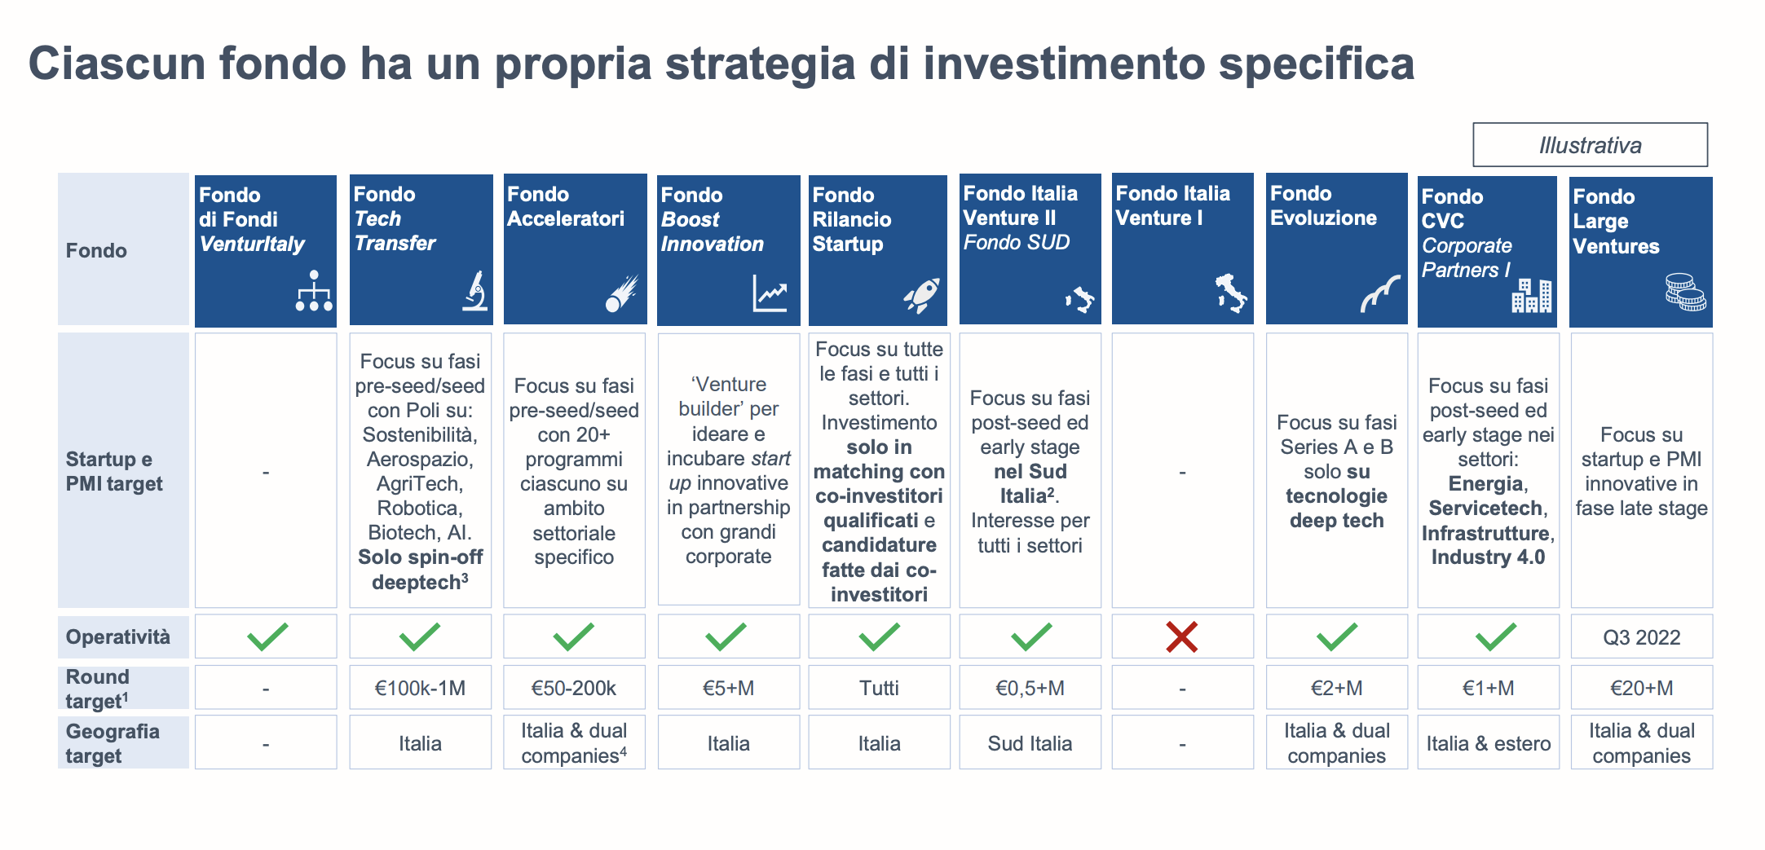
Specific investment strategy for each of the Funds
Fund
Focus on pre-seed/seed stages through
Hubs on SustainabilityRobotics Biotech
Aerospace,
AI
Deeptech spinoffs
Focus on pre-seed/seed stages 18 Accelerator Funds on specific domains each
Venture building approach to ideate and create startups in collaboration with corporates
Target
Startups
and SMEs
Operation

Slide 11
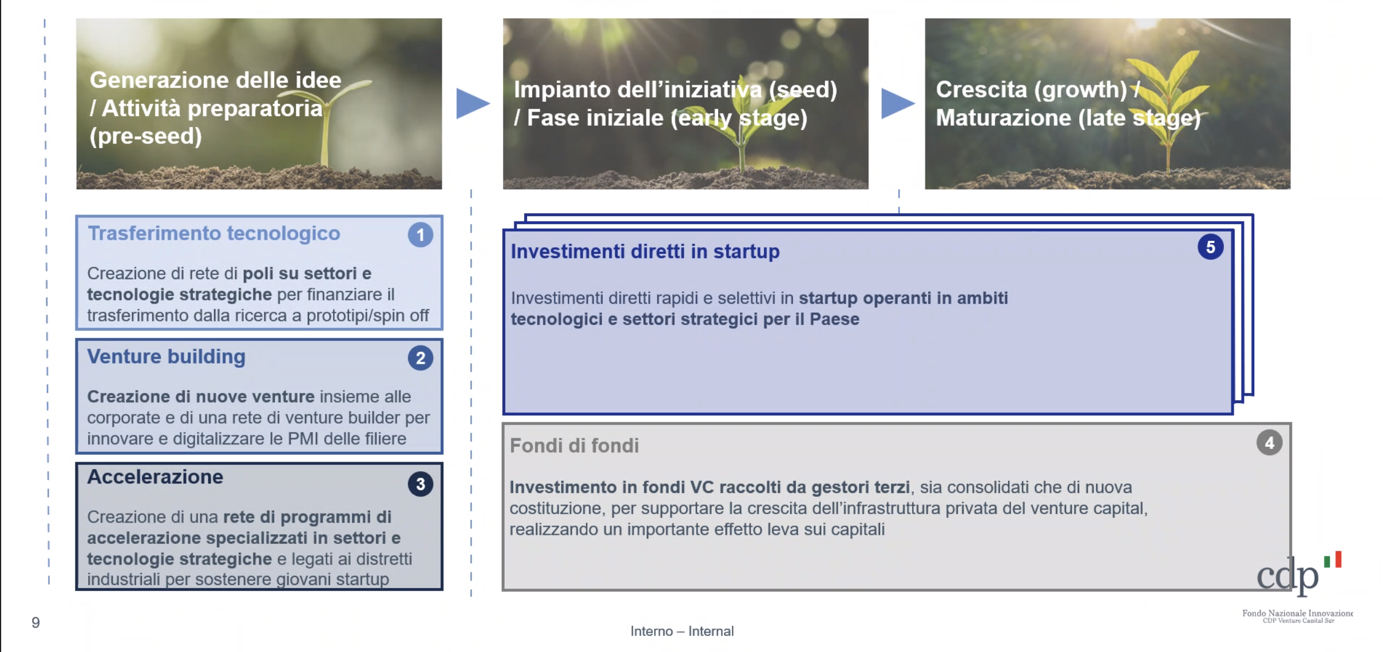
Focus on 5 macro-areas across startups life cycle
1. Technology transfer
Network of Hubs focussing on strategic technologies to foster transfer from research to prototype/spinoffs
4. Direct investments in startups
Quick and selective direct investments in already established startups operating in strategic sectors and technologies for Italy
2. Venture Building
Co-creation of new venture together with Corporates and of new venture builders for innovating and digitalising SMEs
5. Fund of funds
Investments in VC funds raised by third-party managers, both established and newly established, to support the growth of the private venture capital infrastructure, realizing a significant leverage effect on capital
3. Accelerator
Network of specialized Acceleration Programmes in strategic sectors and technologies. Link with industrial clusters to support young starups

Slide 12
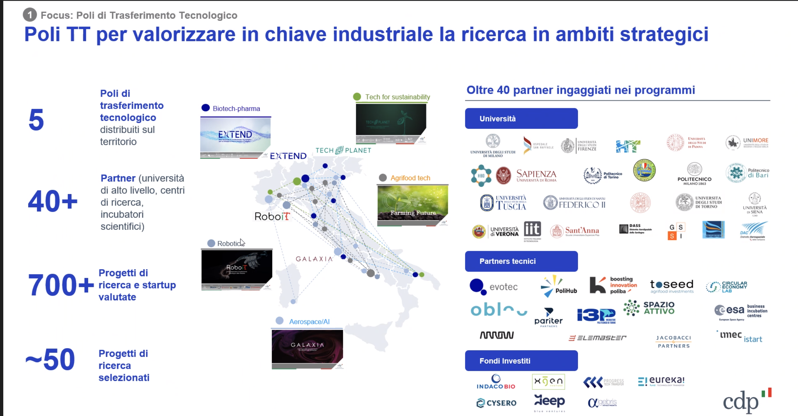
Focus on Tech Transfer Fund
50+ partners engaged
Tech Transfer Hubs across Italian regions
5
Universities
Partners (universities, research centers, incubators, etc.)
40+
Projects
Evaluated from research and startups
Technical partners
1000+
Research projects selected
80+
Invested Funds

Slide 13
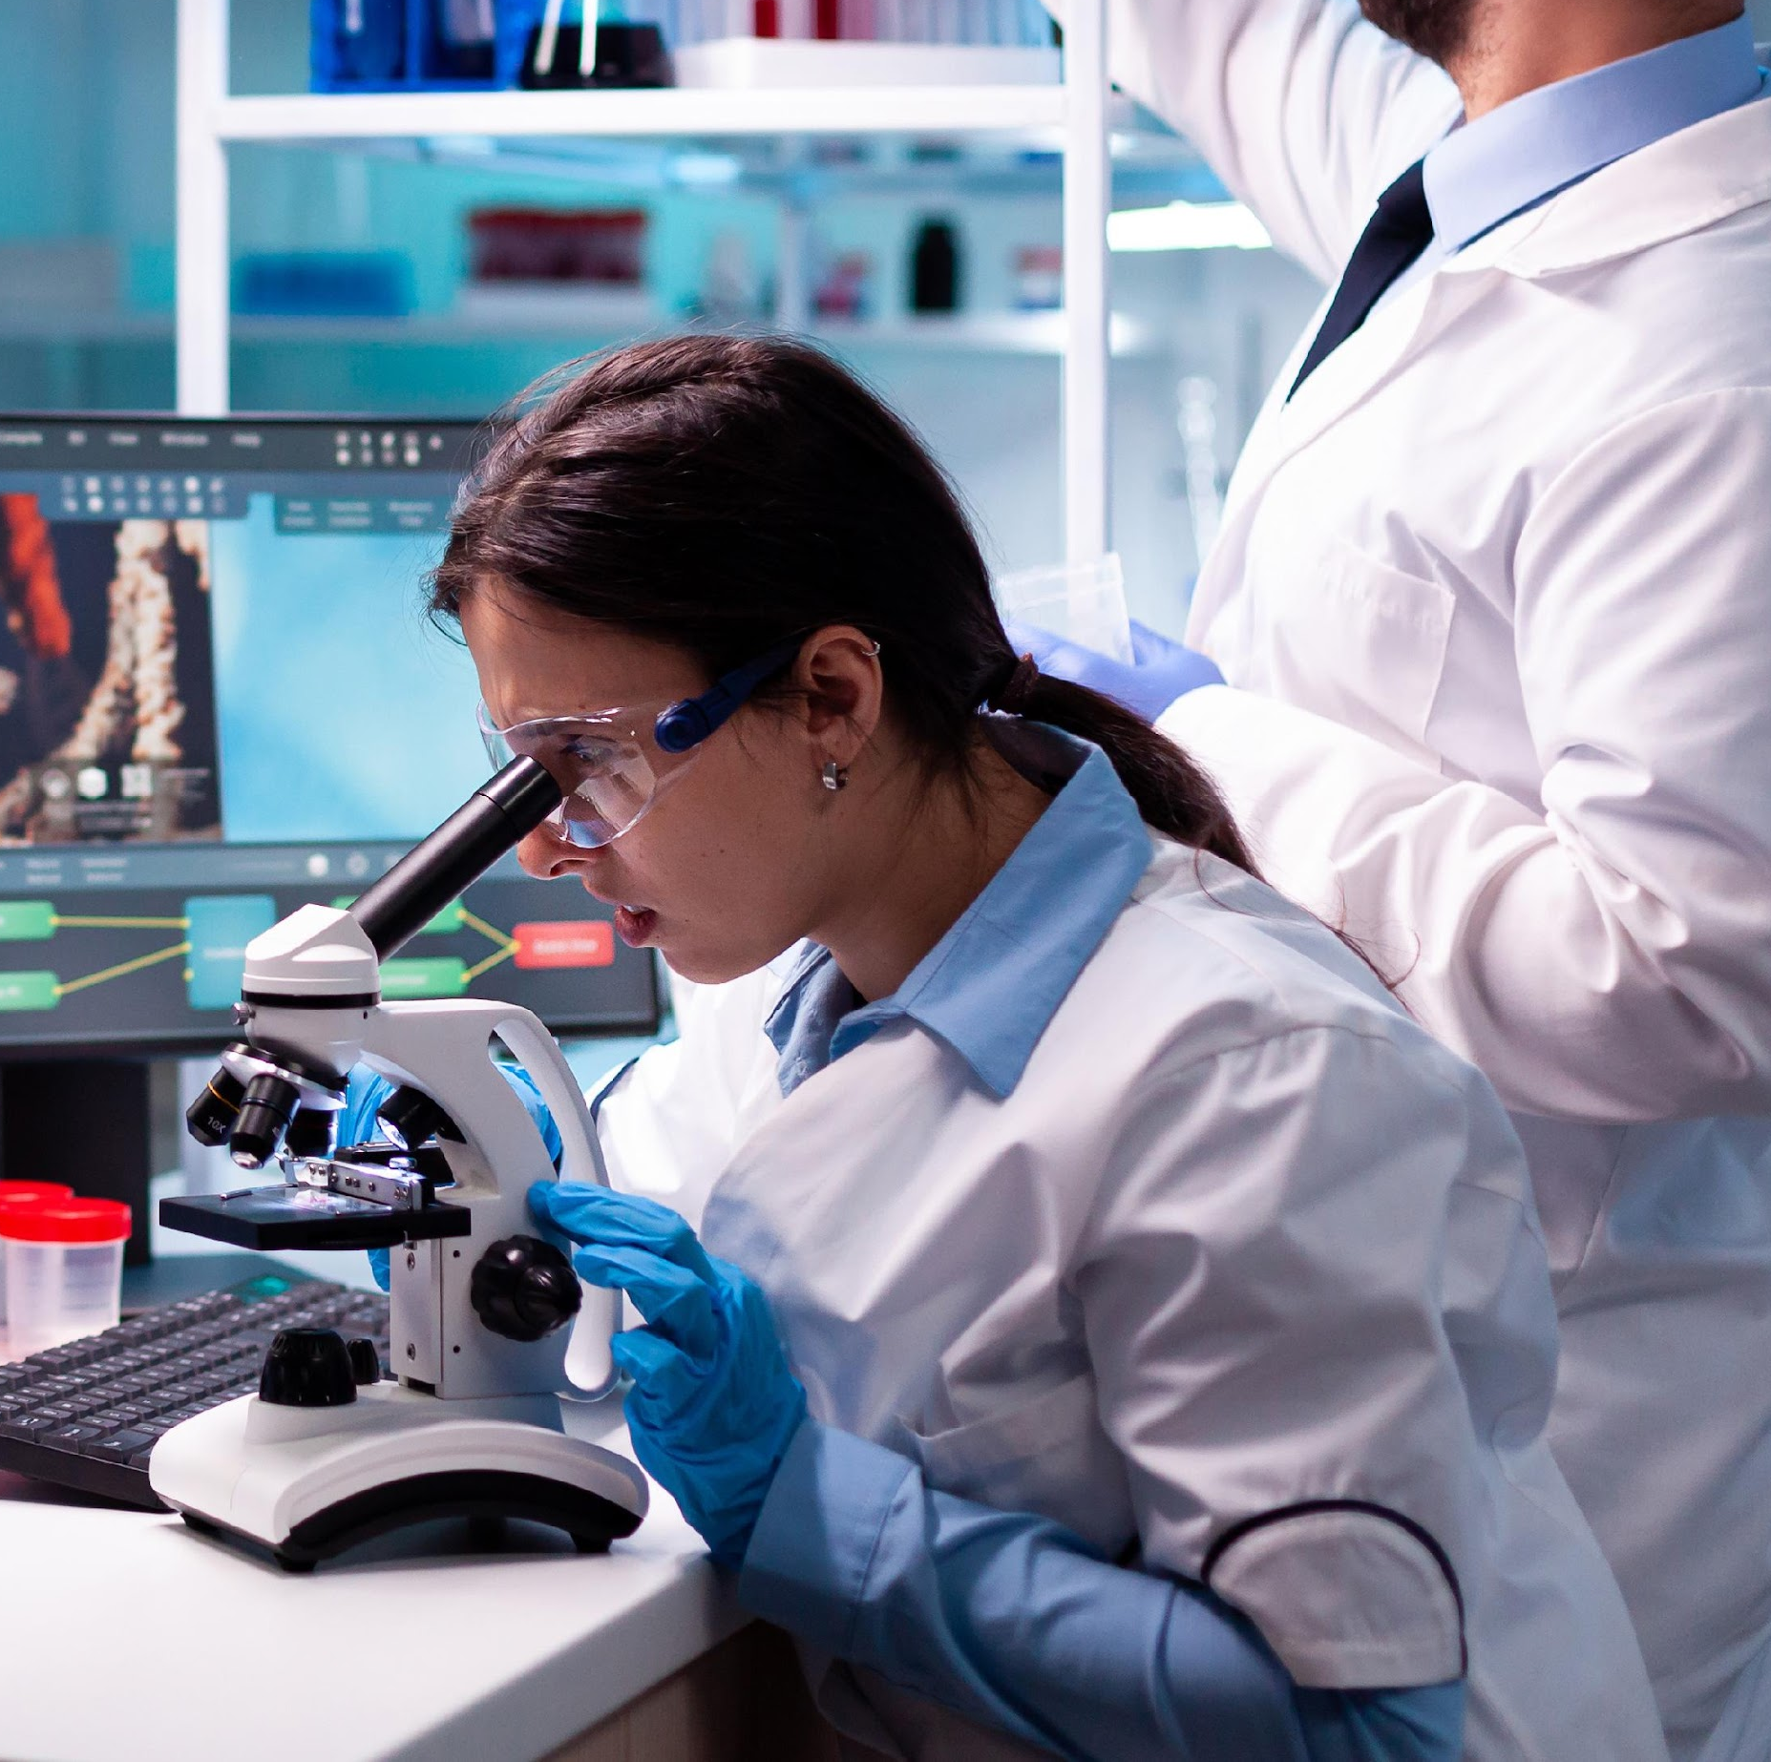
Research skills ok…
But!
Economics Background
Strategic Marketing approach
Proof
of
Concept
Product design and development skills
+
Risk taking attitude
Entrepreneurial mindset
Ip management
Technology expert
Technical background
Operating experience

Slide 14
Accelerating Technology Transfer with AI
🚀 Mission
AI empowers Technology Transfer Offices (TTOs) in European universities by accelerating and enhancing technology transfer (T3) processes through a cutting-edge AI conversational agent.
🤖 Solution
A digital assistant that delivers real-time, expert guidance on IP valorisation and asset management—available 24/7 to researchers and innovators.
💡 Impact
- Streamlines TTO operations with automation and speed
- Fosters seamless collaboration between research and business
- Bridges structural gaps in innovation ecosystems (Draghi Report, 2024)
- Boosts Europe's global innovation competitiveness
🌍 Strategic Vision
Digitising T3 to unlock the full potential of European research and make innovation actionable at scale.

