Slide 1
Code of practice on industry-academia co-creation for knowledge valorisation
Ioannis Sagias
Deputy Head of Unit
Valorisation Policies & IPR Unit
Directorate-General for Research & Innovation

Slide 2

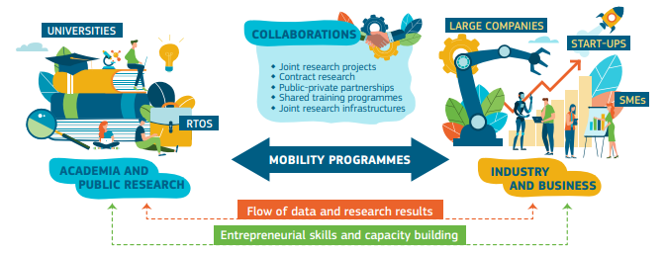


Knowledge valorisation culture
Access to finance:
Investments and funding schemes
Regulatory framework
Intermediaries
Open innovation

Slide 3
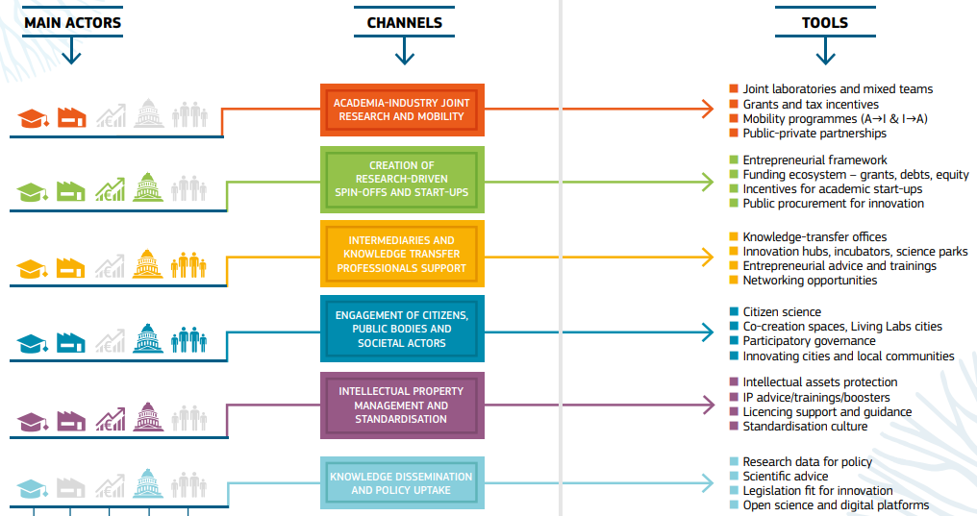

Knowledge valorisation:
Mapping of actors, channels, and tools

Slide 4
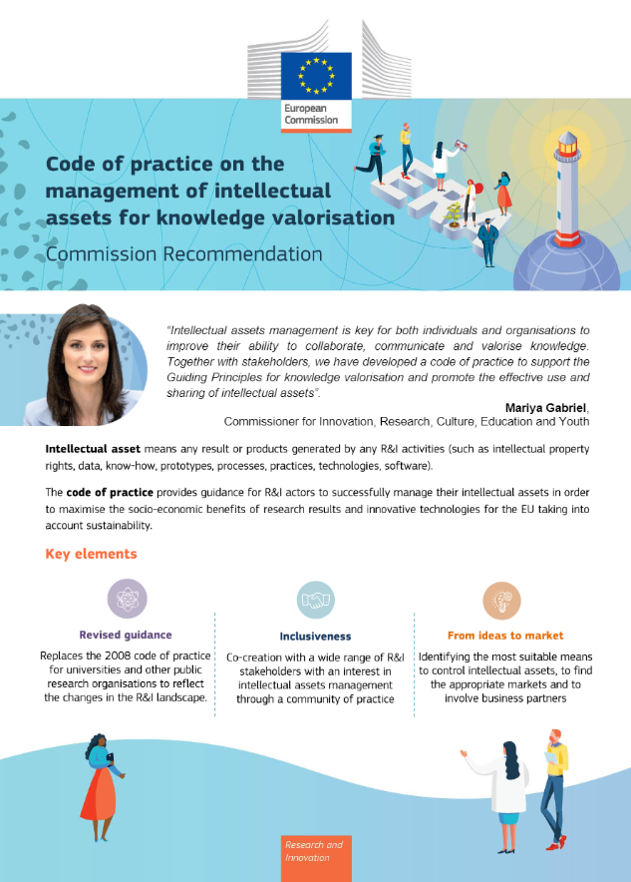
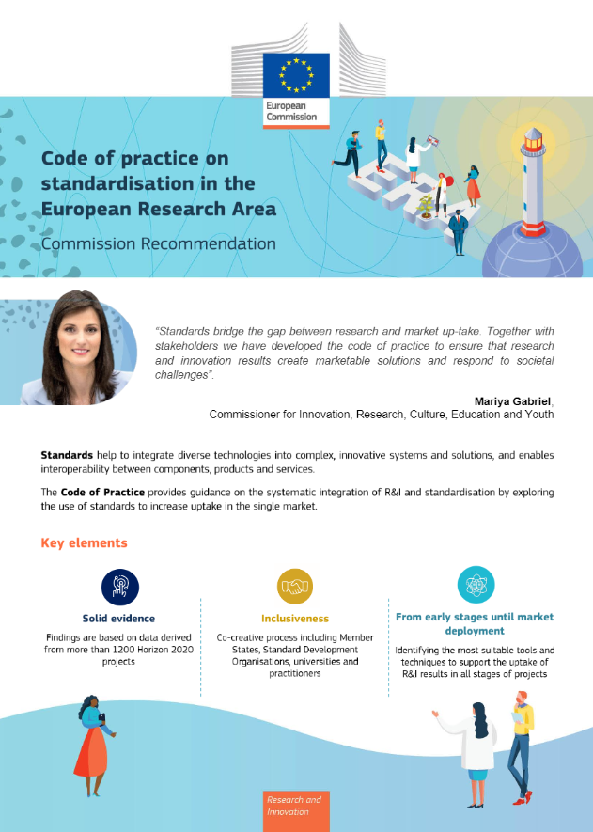
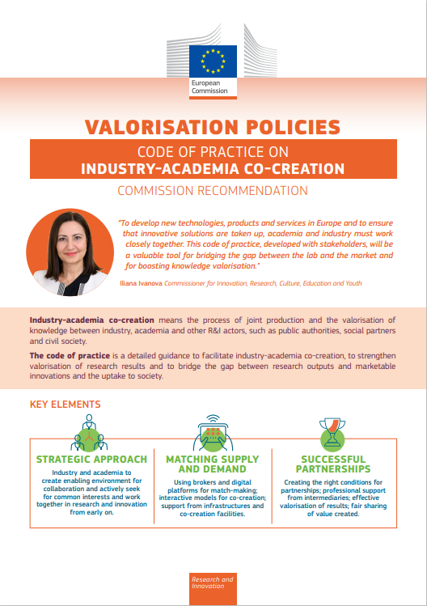
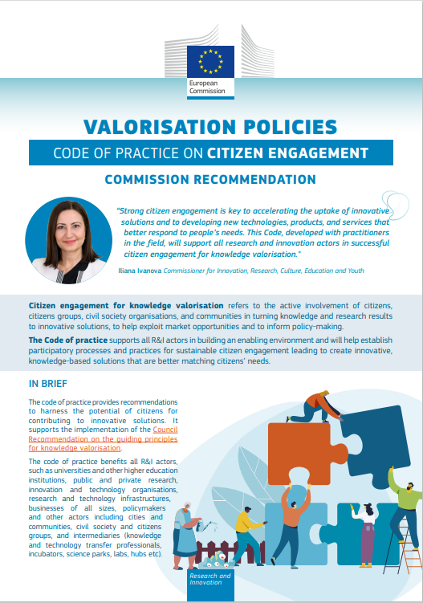
EU guidance for knowledge valorisation
Guiding principles for knowledge valorisation
Council Recommendation (2 December 2022)
Code of practice
on the management of intellectual assets for
knowledge valorisation
Code of practice on standardisation for
knowledge valorisation
Code of practice on industry-academia
co-creation for
knowledge valorisation
Code of practice on citizen engagement for
knowledge valorisation
Commission Recommendations
(1 March 2023)
Commission Recommendations
(1 March 2024)

Slide 5
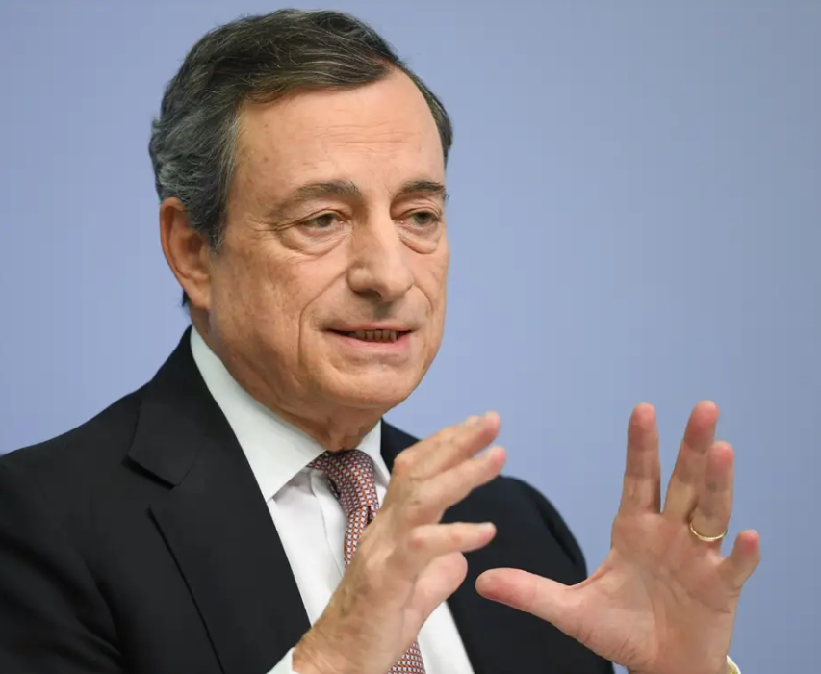
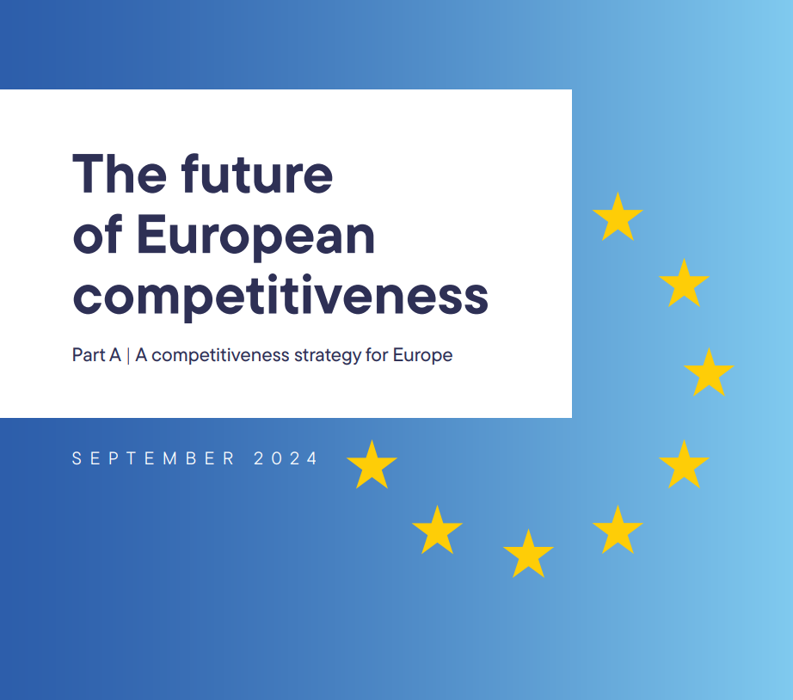
Draghi Report
“A lack of first-class higher education institutions in the EU and weak interaction between universities and businesses limit technology transfer, innovation capacity and ultimately economic growth.“
“The links between higher education and business are weak and researchers have few incentives to become entrepreneurs.”
“…only about one-third of the patented inventions registered by European universities or research institutions are commercially exploited.”

Slide 6


Competitiveness compass: upcoming initiatives
Closing the innovation gap
Startups and Scaleups Strategy enables thriving young innovative companies by:
  improving business-academia collaboration
  creating better prospects for patents to be commercialized and their revenues fairly shared
  facilitating access to risk capital and mobility and talent of skilled workers
European Innovation Act supports access of innovative companies to:
  research and technology infrastructures
  intellectual assets generated by publicly funded R&I in view of increasing patenting
  regulatory sandboxes allowing innovators to develop and test new ideas
European Research Area (ERA) Act proposes a 28th legal regime to:
  simplify applicable rules, including aspects of corporate law, insolvency, labour and tax law
  give a new focus on raising R&D spending and coordinating it on high-impact projects, reinforcing alignment between the EU and Member States’ funding priorities
  foster the circulation of knowledge and talent across Europe.

Slide 7
Code of practice on industry- academia co-creation

Slide 8
Objectives
Support implementation of the Council Recommendation on the Guiding principles for knowledge valorisation adopted on 2 December 2022
Provide concrete recommendations to facilitate industry-academia
co-creation to improve knowledge valorisation:
  Create enabling environment, help establish interactive models supporting industry-academia co-creation, foster the role of intermediaries and digital platforms and better match the supply and demand for innovation.
  Encourage connections and co-creation between all R&I actors and emphasise the importance of entrepreneurial skills and practices in line with the Guiding principles for knowledge valorisation.

Slide 9

Code of practice on industry-academia co-creation (1)
Creating an enabling environment for industry-academia co-creation
Practical recommendations to:
Promote industry-academia co-creation in the organisation’s strategy.
Raise awareness on mutual benefits and value creation opportunities.
Provide incentives for all staff to participate in industry-academia co-creation.
Invest in developing skills and in lifelong learning for strengthened industry-academia co-creation.
Invest in networking, communication and relationship-building to facilitate industry-academia co-creation.

Slide 10

Code of practice on industry-academia co-creation (2)
Managing industry-academia co-creation for effective knowledge valorisation
Practical recommendations to:
Develop a joint-industry-academia partnership framework for effective knowledge valorisation.
Foster the role of intermediaries to encourage and manage sustainable long-term industry-academia co-creation.
Promote valorisation of the outcomes of industry-academia co-creation activities.
Pool resources and engage in joint infrastructures and co-creation facilities to enhance industry-academia co-creation.
Assess the outcomes, value created and impact of industry-academia co-creation activities.

Slide 11





Sharing best practices
Developing a
joint-industry-academia partnership framework
Knowledge Valorisation through Industry Collaboration – Collaborative Laboratories (CoLABs)
Skills Development – Lifelong Learning
EATRIS’s innovative training workshop & curriculum
Networking - Communication - Relationship-building
Photonics Center - Collaboration for Business and ResearchPROMO-TT: Matching research, industry and investors
UNI.MINDS Festival
Pooling Resources – Creating Joint Infrastructures
Open Entrepreneurship Platform
Collaborative research partnerships at AMBER
How to promote bi-directional mobility of knowledge between engineering industries and academia
Circular business support management
Fostering mobility

Slide 12
Further information
Commission Recommendation (EU) 2024/774 on a Code of practice on industry-academia co-creation
http://data.europa.eu/eli/reco/2024/774/oj
Factsheet on industry-academia co-creation
https://research-and-innovation.ec.europa.eu/document/download/045ede1a-f0c0-495b-9510-4c56f850bed8_en
Video on the Code of practice on industry-academia co-creation
https://www.youtube.com/watch?v=_q2nAjWWGvc
Guidance on the Guiding principles for knowledge valorisation and the Codes of practice
https://research-and-innovation.ec.europa.eu/research-area/industrial-research-and-innovation/eu-valorisation-policy/knowledge-valorisation-platform/guiding-principles-knowledge-valorisation-and-implementing-codes-practice_en

Slide 13
Knowledge valorisation policy activities

Slide 14



Mutual Learning Exercise (MLE)
Knowledge Valorisation - Focus on skills, intersectoral cooperation and incentive systems
18 participating countries
Topics:
‘Incentives and skills’
a) Policy and legal context, governance and funding (Madrid, 24/25 Jan. 2024)
b) Research talent (Vienna, 19/20 June 2023)
‘Intermediaries’ (Stockholm, 20/21 Sept. 2023)
‘Networks and Processes’ (Helsinki, 23/24 Nov. 2023)
‘Intellectual Assets Management’ (cross-cutting)
Final report was presented on 5 June 2024 in an event under the Belgian Presidency
The final report and the topical reports are published on the Europa webpage

Slide 15

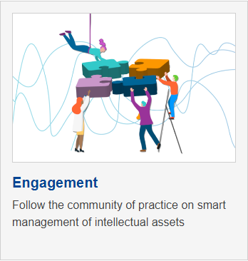

The EU Knowledge Valorisation Platform
Newsletter launched in September 2023
Visit the platform and subscribe to the newsletter: Knowledge Valorisation Platform (europa.eu)

Slide 16

Upcoming EU Knowledge Valorisation Talks
AI and other digital techs: a revolution in knowledge valorisation? Thursday 27 June 2024 (from 13:00 to 13:30/45)
Research security: dealing with risk in intellectual assets management. Tuesday 24 September 2024 (from 13:00 to 13:30/45)
Social Sciences and Humanities: untapped potential for innovative solutions and better policies. Tuesday 19 November 2024 (from 13:00 to 13:30/45)

Slide 17
Have your say

Slide 18


Survey for feedback on the uptake of the
Codes of practice
Objectives
Inform about the awareness of the R&I actors on the Codes of practice for knowledge valorisation and gather feedback on the uptake of the Codes
Methodology
Open survey
Timeline
26 March 2025: Opening of the survey
30 May 2025: Closure of the survey
Access the survey: link or QR code

Slide 19


Thank you
Knowledge Valorisation Newsletter
RTD-VALORISATION-POLICIES-IPR@ec.europa.eu
Slide01: ©luismolinero #281962386, 2023. Source : stock.adobe.com. Slide xx: element concerned, source: e.g. stock.adobe.com
Unless otherwise noted the reuse of this presentation is authorised under the CC BY 4.0 license. For any use or reproduction of
elements that are not owned by the EU, permission may need to be sought directly from the respective right holders.
© European Union 2023

