Slide 1
European IP Helpdesk
National Knowledge Valorisation Day
Jörg Scherer
Skills and capacities for knowledge valorisation
Warsaw, 27 May 2025

Slide 2







The EC IP Helpdesks
www.ec.europa.eu/ip-helpdesk
Notes:
Geographical Coverage:
Europe
China: Mainland China, Macao, Hong Kong, Taiwan
South-east Asia: Vietnam, Thailand, Indonesia, Singapore, Philippines, Malaysia, Cambodia, Lao, Myanmar, Brunei
Latin America: Argentina, Bolivia, Brazil, Chile, Colombia, Costa Rica, Cuba, Ecuador, El Salvador, Guatemala, Honduras, Mexico, Nicaragua, Panama, Paraguay, Peru, Uruguay, Venezuela
India
Africa
WHAT:
Provision of free of charge, first-line confidential assistance on IP protection, management and enforcement
WHY:
to support IP capacity building along the full scale of IP practices: from awareness to strategic use and successful exploitation
IP is a key business assets!
to strengthen EU competitiveness
to ensure long-term impact
increase the willingness to enter into collaboration
for an increased translation of IP into the EU innovation ecosystem!
WHO:
EU / COSME SMEs & Start-ups
EU innovation stakeholders and multipliers
current and potential beneficiaries of EU-funded projects (researchers and SMEs) – EU IP HD

Slide 3
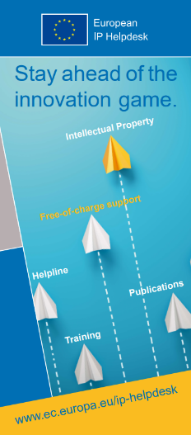
European IP Helpdesk
Service initiative of the European Commission
Addressing current and potential beneficiaries of EU-funded projects, researchers and EU SMEs
Free-of-charge first-line support on intellectual property (IP)
Hands-on IP and innovation management support
International pool of IP experts from various thematic fields
Unique cooperation scheme with the Enterprise Europe Network: 43 IP ambassadors from 26 EU countries
Notes:
We are the European IP Helpdesk a first-line intellectual property (IP) service providing free-of-charge support to help European SMEs and beneficiaries of EU-funded research projects manage their IP in the context of transnational business or EU research and innovation programmes.
The European IP Helpdesk supports European SMEs and research teams involved in cross-border business and/or EU-funded research activities manage, disseminate and valorise their IP. Offering a broad range of informative material, a Helpline service for direct IP support as well as on-site and online training, our main goal is to support IP capacity building along the full scale of IP practices: from awareness to strategic use and successful exploitation.

Slide 4







European IP Helpdesk Services
Publications
practical IP knowledge through high-level publications
Website
frequent updates from the world of IP and innovation
Helpline
confidential treatment of individual IP questions
Ambassadors
local IP support throughout Europe
Training
free online and on-site sessions
Events
info point at key networking events and conferences
Notes:
We are the European IP Helpdesk a first-line intellectual property (IP) service providing free-of-charge support to help European SMEs and beneficiaries of EU-funded research projects manage their IP in the context of transnational business or EU research and innovation programmes.
The European IP Helpdesk supports European SMEs and research teams involved in cross-border business and/or EU-funded research activities manage, disseminate and valorise their IP. Offering a broad range of informative material, a Helpline service for direct IP support as well as on-site and online training, our main goal is to support IP capacity building along the full scale of IP practices: from awareness to strategic use and successful exploitation.

Slide 5
Valorisation Channels and Tools
Intermediaries and knowledge transfer professional support
Intellectual property (IP) management and standardisation
Engagement of citizens and local communities
Creation of research-driven spin-offs and start-ups
Academia-industry joint research and mobility
Knowledge dissemination and policy uptake

Slide 6
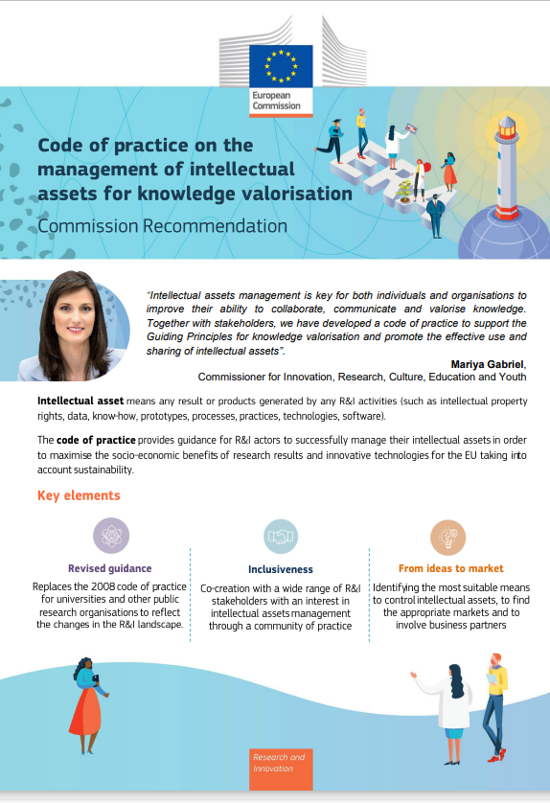
Codes of practices – Intellectual assets management
Establishing strategy for effective IA managment
Defining and adopting strategic intellectual assets management practices
Managing intellectual assets in a way that enables open science and open innovation
Managing intellectual assets in joint research and innovation activities
Clarifying ownership of intellectual assets as early as possible
Establishing clear collaboration conditions
Bridging the gap from intellectual assets creation to the market
Finding suitable means for control
Carrying out valuation of intellectual property
Investing in education, training and awareness raising
Establishing monitoring, transfer and licensing practices
Notes:
aims to increase the use of research results and accelerate the uptake of innovative technologies. It provides comprehensive recommendations and addresses specific challenges faced by research and innovation stakeholders such as the efficient management of intellectual assets in joint research activities and the development of research and innovation activities in open science and open innovation contexts. Intellectual assets are not limited to IP rights, but include any result or products generated by research and innovation activities such as publications, data and know-how to maximise value creation opportunities.

Slide 7


European IP Helpdesk supporting resources
IP Training: KV: Concept, Policies and Practice
Bulletins
  European IP Helpdesk Bulletin, Insights: Code of Practice on the Management of Intellectual Assets for Knowledge Valorisation
  Industry-Academia Collaboration – to be published in June 2025
IP Specials:
  Knowledge Valorisation in the EU-13 Countries
  Open Science
IP Guides:
  Successful Valorisation of Knowledge and Research Results in Horizon Europe
Notes:
Bulletin: Code of Practice on the Management of Intellectual Assets
Focus: Guidance aligned with the new EU Code of Practice.
Includes: Definitions, best practices, tools, and links to institutional strategies.
Use at event: Direct policy alignment with the session on IA management.
Bulletin: Code of Practice on Industry–Academia Collaboration (June 2025 edition)
Focus: How to implement meaningful, IP-aware collaboration models.
Includes: Frameworks, challenges, use cases, and actionable tips.
Use at event: Complements the parallel session on nurturing collaboration.
IP Special: Knowledge Valorisation in the EU-13 Countries
Focus: Challenges and opportunities in Widening countries.
Why it supports KV: Highlights capacity-building needs, institutional examples, and national policy environments for valorisation.
Use at event: Demonstrates targeted support for countries like Poland.

Slide 8

Helpline
Free-of-charge, first-line IP support
Confidential, personal and “to the point”
Answer within 3 working days
Contact via email or phone
Registration on website to submit question
Notes:
42% of our customers / users of the Helpline Service are Universities
32% are SMEs

Slide 9

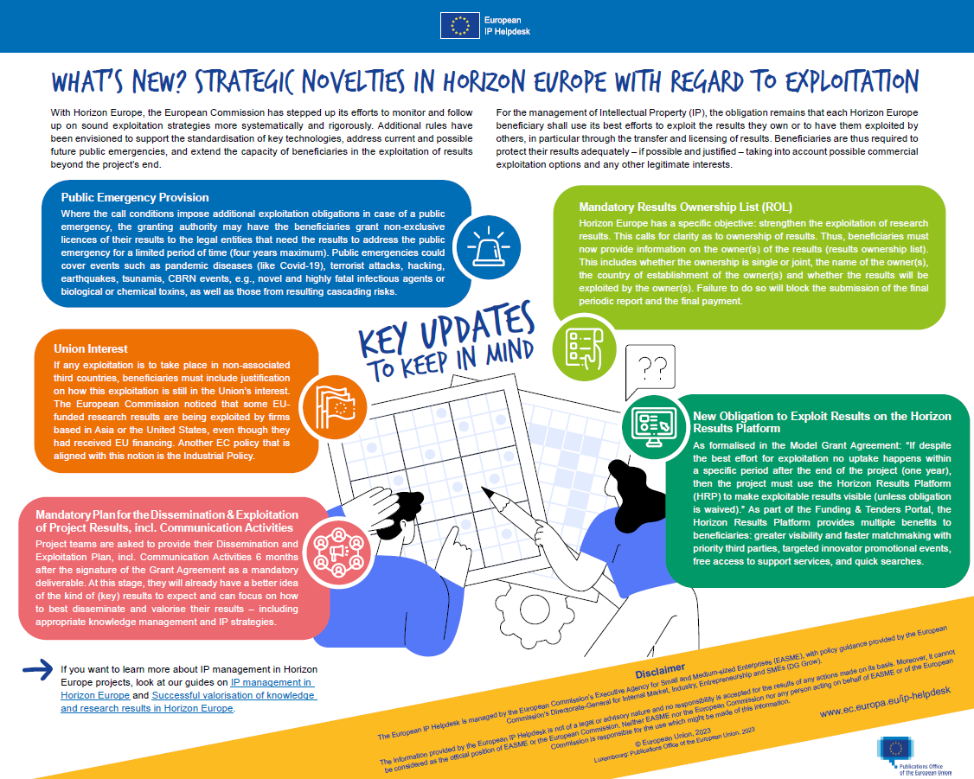

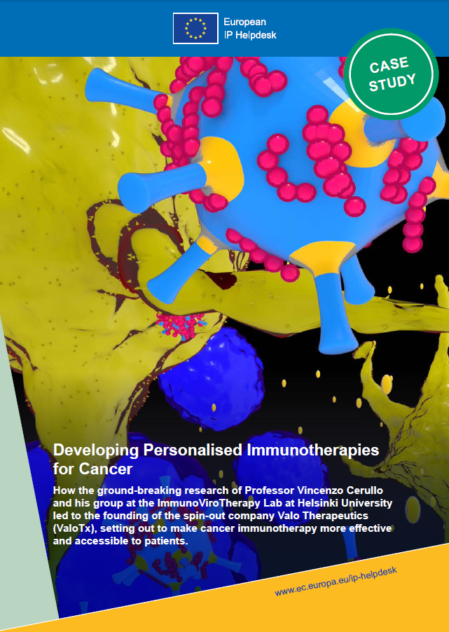
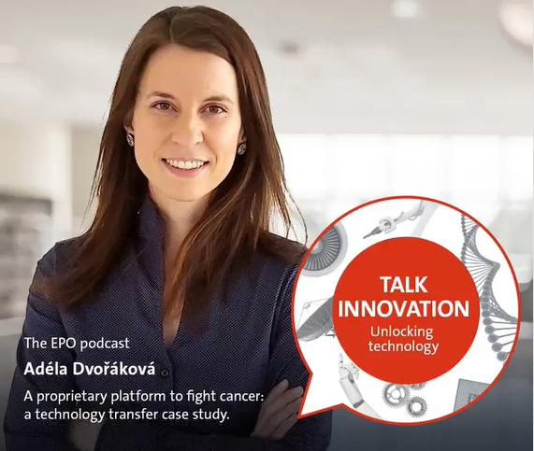

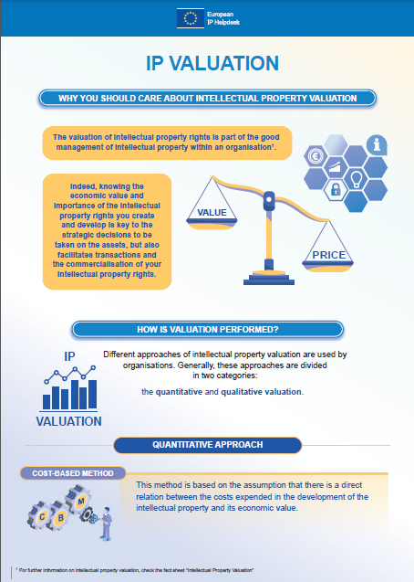


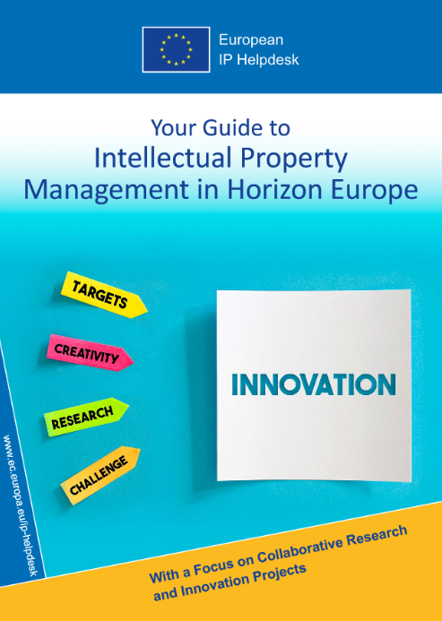

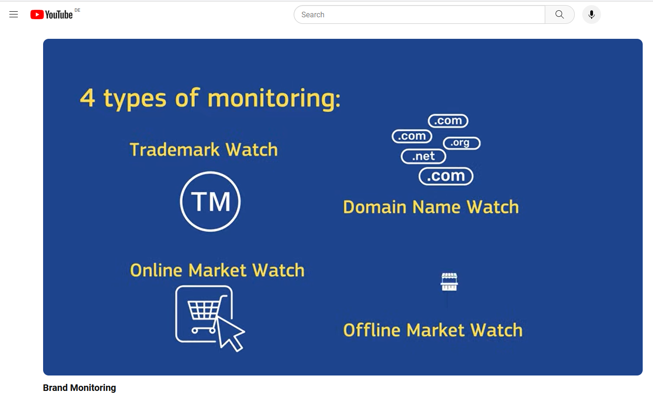
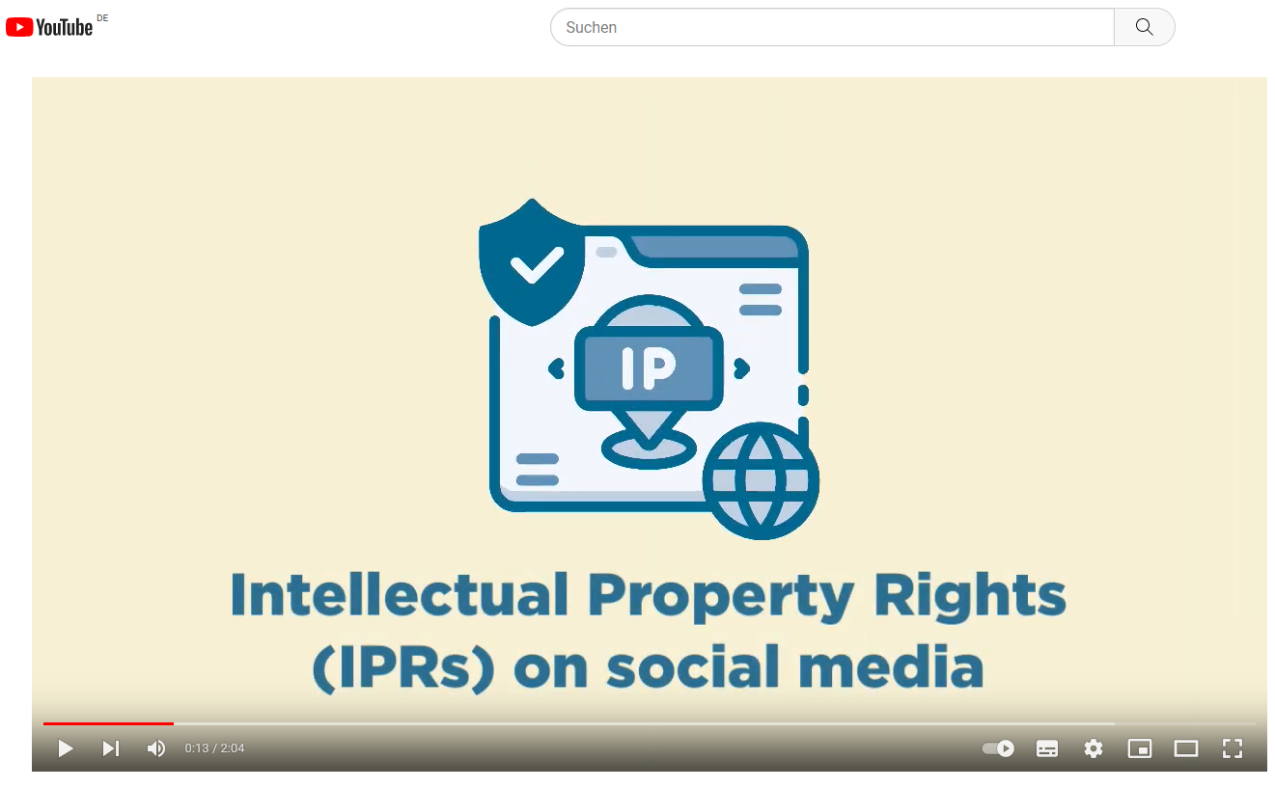
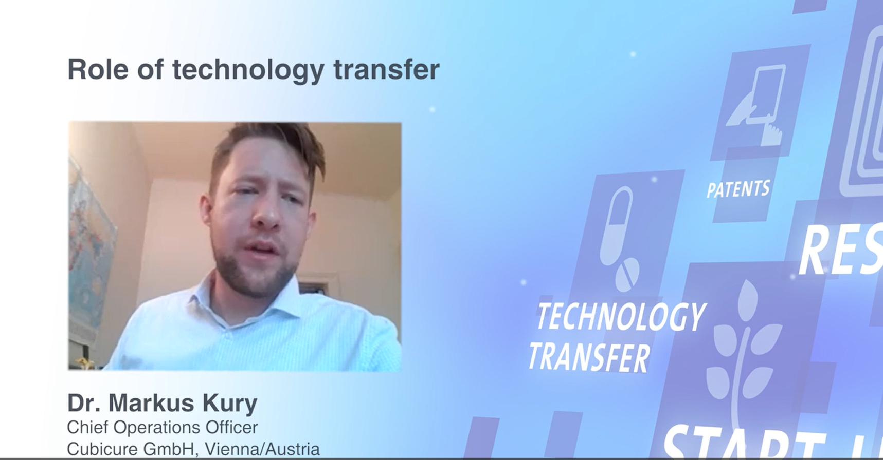
Communication & Publication Formats
Bulletins
Infographics
Podcast
Case Studies
Fact Sheets
Guides
Audio-visual Material

Slide 10
Structure of Resources
IP Basics
IP in EU funded Projects
  Basic / Intermediate / Advanced level of knowledge
  Preparation Phase / Implementation Phase / Exploitation Phase
  Cases covering the full project lifecycle
IP in Business
  Basic / Intermediate / Advanced level of knowledge
  Sector specific
  Industry – Academia

Slide 11
The European IP Helpdesk offers specific training for
Researchers – on IP in Horizon Europe, Open Science, and exploitation
Start-ups & SMEs – on IP strategy, protection, and commercialisation
National Contact Points (NCPs) – to support advisory services on IP in EU funding
Technology Transfer Offices (TTOs) – on licensing, spin-offs, and knowledge valorisation
University staff & research managers – to strengthen institutional IP support
Innovation intermediaries – including EEN, clusters, and incubators
Policy makers & stakeholders – on IP’s role in innovation ecosystems

Slide 12
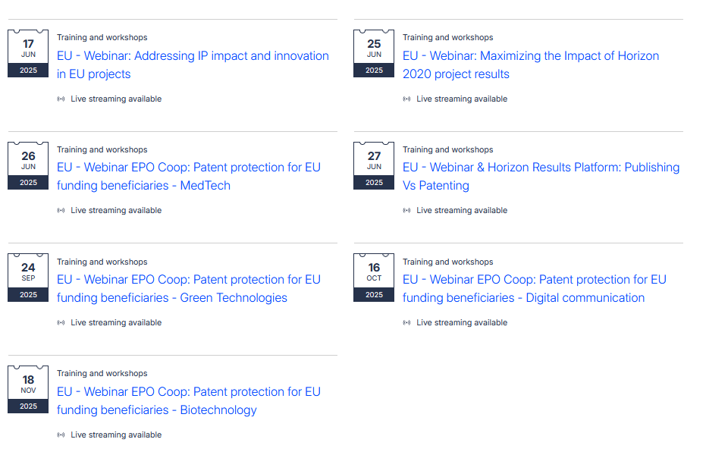

Upcoming Training
Not Exhaustive

Slide 13
Tailored IP Training for EU Funding Programmes
EIC (Pathfinder, Transition, Accelerator)
MSCA (Marie Skłodowska-Curie Actions)
Horizon Europe Collaborative Projects (RIA, IA, CSA)
Lump Sum Projects
Widening Participation & Spreading Excellence
Interregional Innovation Investments (I3)
Notes:
🔍 Why Lump Sum Projects Differ (from an IP management perspective):
1. No Financial Reporting = Greater Focus on Results
Since beneficiaries don’t report actual costs, the evaluation of project progress shifts more toward outputs and deliverables, including IP generation and exploitation plans.
This increases the importance of strategic planning for IP from the outset — especially how results will be used, protected, or shared.
2. Work Package Completion Is Critical
Payments are only made when entire work packages (WPs) are completed.
If a WP includes deliverables like proofs of concept, patent filings, or licensing plans, those IP outputs become gating elements for funding — reinforcing the need for clear IP ownership and responsibilities within the consortium.
3. Greater Need for Internal Clarity
Because cost claims don’t trigger audits, internal misunderstandings about who owns what or who has rights to use results can surface later — especially when exploitation is involved.
Strong IP clauses in the Consortium Agreement and early alignment are therefore essential.
4. Simplified Reporting Can Obscure IP-Related Costs
There's no itemised cost breakdown, so IP-related expenses (e.g. legal advice, patent filing, licensing support) are not visible or isolated in the financial report — meaning they must be justified by their role in achieving the WP deliverables.

Slide 14
Sector-Specific IP Training Topics
Quantum Technologies
Medtech
Biotech
Artificial Intelligence (AI)
Creative Industries
Health & Life Sciences
Digital Communication & Connectivity
Green & Sustainable Technologies

Slide 15
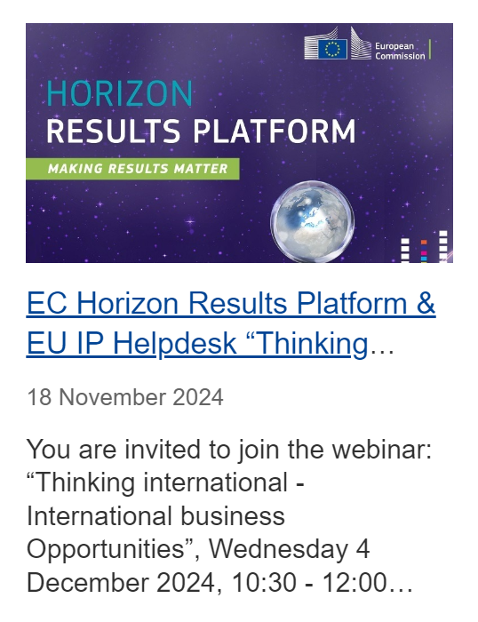
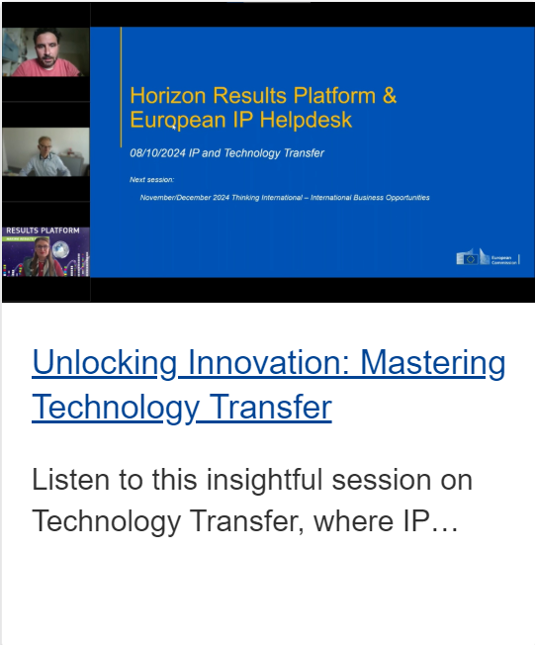

Strategic Partnerships – Training
Horizon Results Platform
Notes:
1. EU - Webinar & Horizon Results Platform: IP in Business collaborations for SMEs and Start-ups https://intellectual-property-helpdesk.ec.europa.eu/news-events/upcoming-events/eu-webinar-horizon-results-platform-ip-business-collaborations-smes-and-start-ups-2025-03-04_en
2. EU - Webinar & Horizon Results Platform:: AI Act https://intellectual-property-helpdesk.ec.europa.eu/news-events/upcoming-events/eu-webinar-horizon-results-platform-ai-act-2025-03-20_en

Slide 16
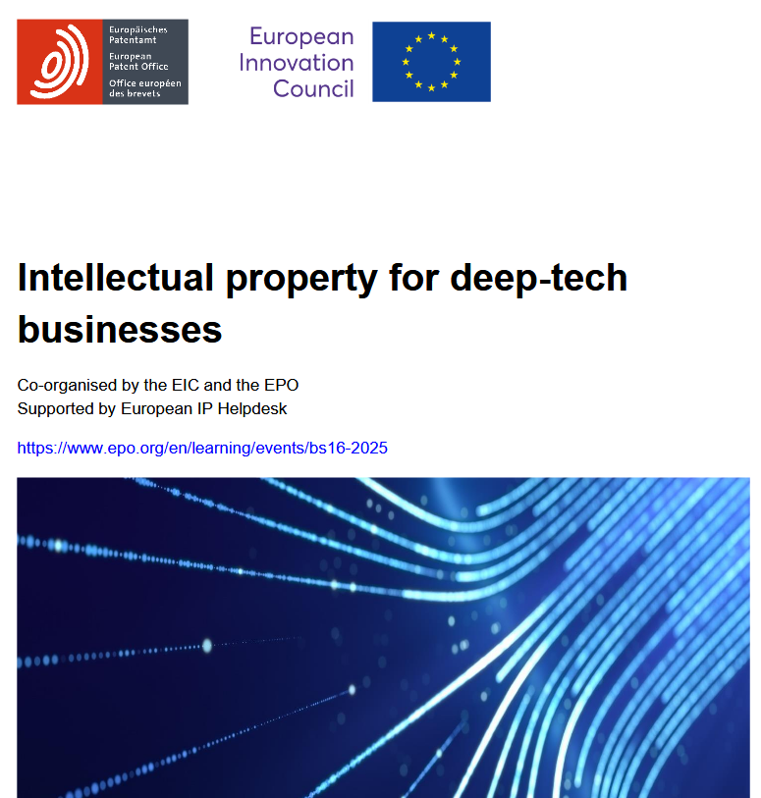

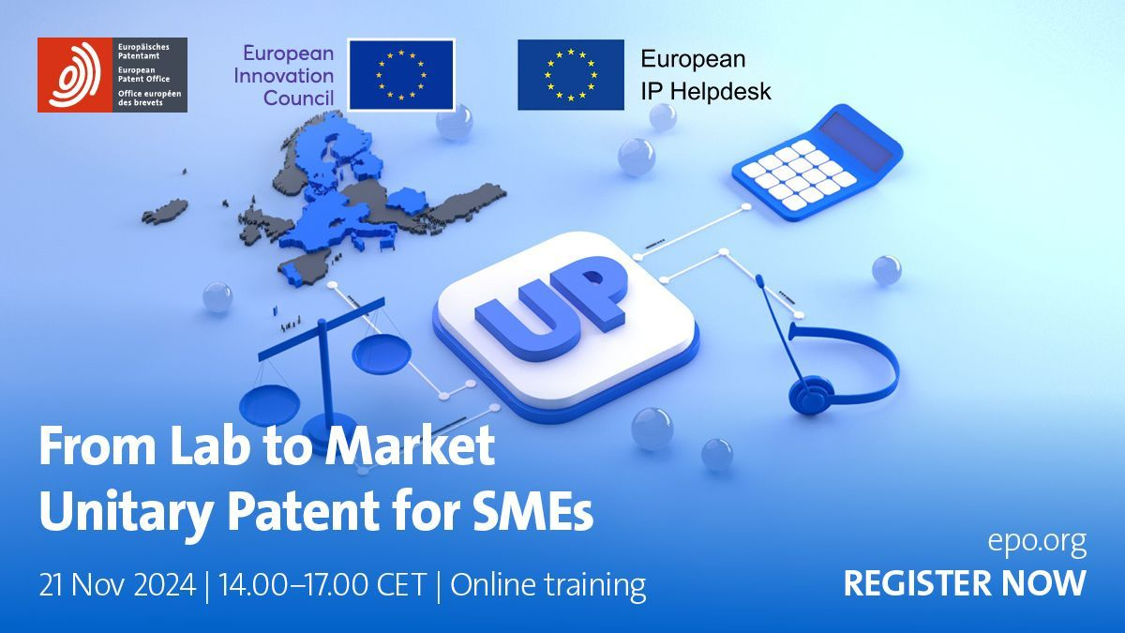
Strategic Partnerships – Training
EPO / EIC
Notes:
IP strategy day: 11 June 2025, 14.00-17.00 hrs CEST
IP management day: 18 June 2025, 14.00-17.00 hrs CEST

Slide 17
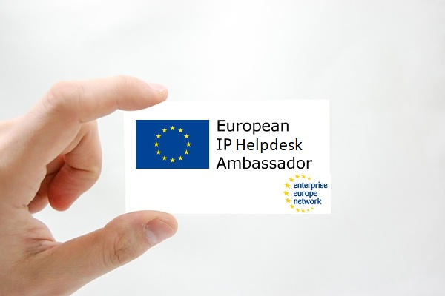
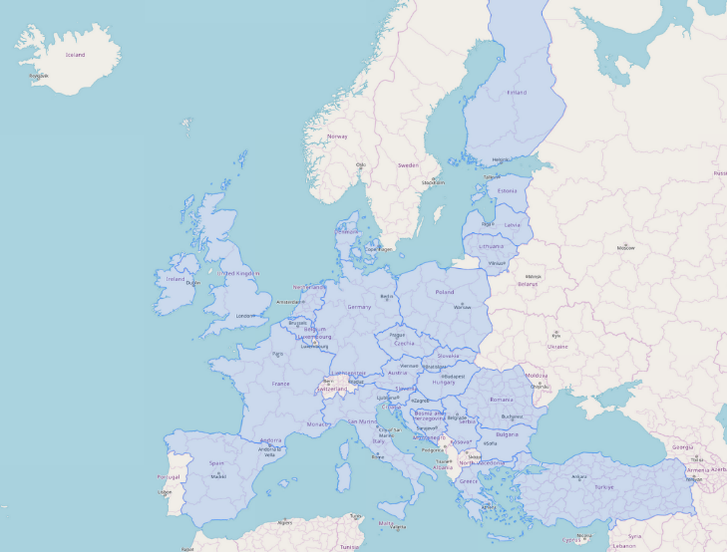
IP Ambassador Network
Since 2013
43 IP Ambassadors – 26 countries
Building IP capacities among European SMEs
Overcoming language barriers
Making the topic more accessible
Exchange and feedback from ambassadors on needs of SMEs
Local awareness and training events
EEN-Contact in Poland: Tomasz Łyżwiński
Regional Centre for Innovation and Technology Transfer, Szczecin

Slide 18



Examples of other related IP&Inno Activities

Slide 19


Unpacking the possibilities of Intellectual Properties for Open Science
Mission and Leadership: IP4OS aims to enhance capacity in IP rights management to support Open Science and the dissemination of FAIR research outputs. The project is led by Kiel University, with eight partners in the consortium.
Key Activities: Developing a framework on IP and Open Science, publishing a best practice manual for researchers and technology transfer professionals, and focusing on advocacy, training, and community building.
https://www.ip4os.eu/
Notes:
IP4OS's mission is to build capacity in how Intellectual Property rights management can support Open Science to promote the dissemination of Findable, Accessible, Interoperable, and Reusable (FAIR) research outputs. The project consortium has eight partners and is led by Kiel University.
The project will develop a framework illustrating the relationship between Intellectual Property rights and Open Science. It will also publish a best practice manual containing practical recommendations aimed at researchers and technology transfer professionals. The work package containing these elements will be led by Karolinska Institutet. The project will also work on awareness and advocacy; training and education; and community building.

Slide 20

Intellectual Asset Management For Research and Entrepreneurship
Mission:
To empower public research organizations (PROs) and academic institutions (AcIs) by enhancing their capacity in knowledge valorisation and standardisation, fostering innovative ecosystems where intellectual property management drives societal and economic value.
Vision:
To become a leading catalyst in transforming research outcomes into impactful innovations, enabling a sustainable, knowledge-driven European Research Area that excels in standardisation and IP management.

Slide 21

Impact Licensing Initative
Innovative licensing practice consisting of reusing and re-purposing intellectual assets for the benefit of society without compromising the already existing economic returns
Involves granting time-bound, voluntary permission by technology holders to access their intellectual property (IP), a technology, a product, or service under preferred conditions to a predefined market
Meeting specified societal purposes, such as addressing unmet social or environmental needs, or responding to crisis situations
Notes:
Community of Practice and creation and application for the network of clearing houses

Slide 22

Thank you! QUESTIONS?
www.ec.europa.eu/ip-helpdesk
helpline@iprhelpdesk.eu
training@iprhelpdesk.eu
X @iprhelpdesk
LinkedIn /european-ipr-helpdesk
Subscribe / Newsletter

