Slide 1
widerAdvance Facility
RESEARCH
INNOVATION
COLLABORATION
Indroduction to the call

Slide 2

widerAdvance Facility
Duration of 48 months: 01.01.2025 – 31.12.2028
RESEARCH
INNOVATION
COLLABORATION
Main objective
Empowering Widening countries and Outermost Regions to bridge gaps, sustain progress, and amplify their role in EU innovation through exploitation and dissemination of projects results.
Valorisation of knowledge.

Slide 3
Target groups
Organisations from Widening Countries and Outermost Regions
Focus on Key Exploitable Results (KERs)​ and related Research Teams (RTs)
Direct or indirect link to Widening actions
Staff of Research Management and Administration (RMAs)

Slide 4




Expected results of the Facility
Strengthened D&E capacities of up to 1000 individuals as part of RTs and/or RMAs.
100+ organisations involved from Widening Countries.
Increased maturity level of 750 KERs linked to Widening actions (directly or indirectly).
Increased recognition of widening beneficiaries in relevant Countries at national, regional level.

Slide 5






Services of the Facility
D&E Academy to improve maturity of selected KERs.
50 editions targeting up to 15 KERs each.
Support with intangible assets via specialised coaching. 35 services to up to 3 KERs each.
Support with standardisation
via specialised coaching.
Up to 15 KERs supported.
Preparation to match with third parties.
30+ editions targeting up to 10 KERs each.
Awareness and training webinars increasing D&E capacities.
1000 RTs and RMAs involved.
Matchmaking events between RTs and relevant innovation stakeholders.
20+ events with 60+ participants each.
Study visits
to access best practices. 4 visits for 80+ RTs/RMAs.
Training, coaching, and mutual learning on synergies with other EU instruments.

Slide 6
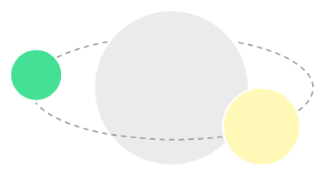



How to participate?
RESEARCH
INNOVATION
COLLABORATION
Through a unique Open Call officially launched on 28 May and available until September 2028.
Applications submitted at any time through an on-line application form in the Facility's website.
Applications collected and assessed at pre-defined cut-off dates (every 3 months) to allocate the different services to the eligible organisations.
Each organisation can present multiple KERs, RTs and RMAs.
High frequency
High flexibility

Slide 7


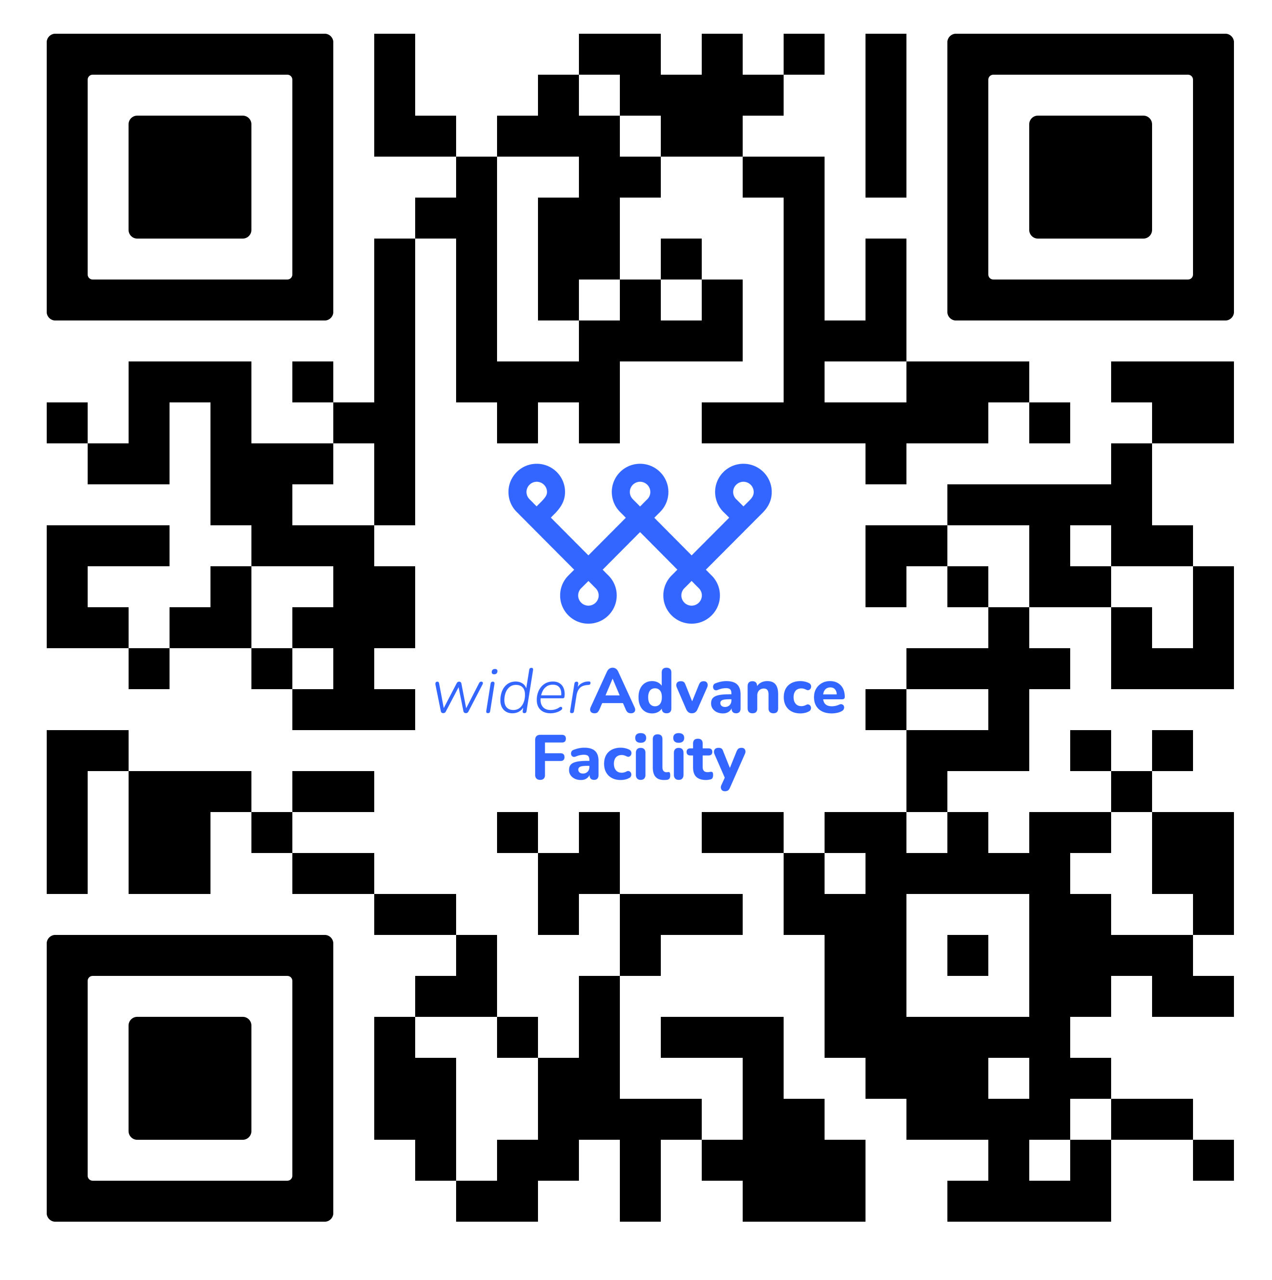

RESEARCH
INNOVATION
COLLABORATION
Contact us
info@widerAdvance.eu
This project has received funding from the European Union’s Horizon Europe Programme under Grant Agreement No. 101159516.
www.widerAdvance.eu

