Slide 1
From atomic physics to quantum sensing in space
Michał Parniak
27.05.2025, National Knowledge Valorisation Day, Univeristy of Warsaw, Poland

Slide 2



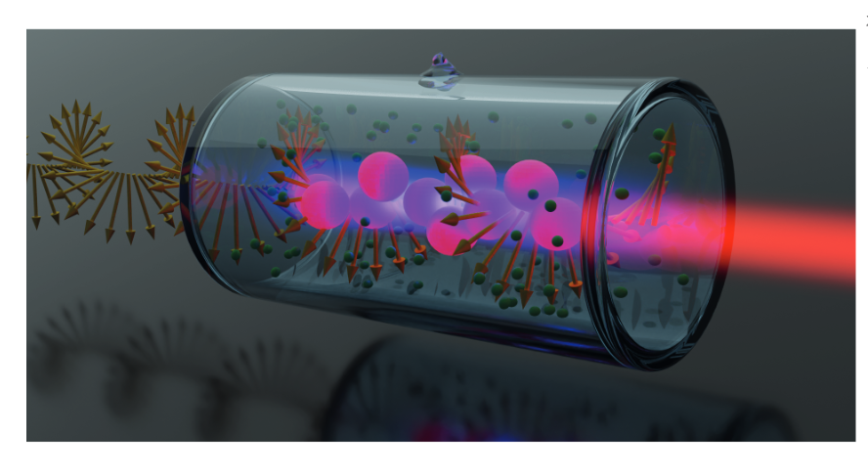


Quantum Optical Technologies
From atomic physics to quantum sensing in space
www.qot.uw.edu.pl / www.qodl.eu
2018-2023
2024-2029
MAB/2018/4
FENG.02.01-IP.05-0017/23

Slide 3



Michał Parniak
Cold atoms (MOT), Quantum memories,
Quantum information
2012-2018
Cavity quantum optomechanics,
hot atoms
2018-2021
2021-
Rydberg atoms (hot/cold),
analog optical quantum signal processors (e.g. for superresolution spectroscopy)
www.qodl.eu

Slide 4
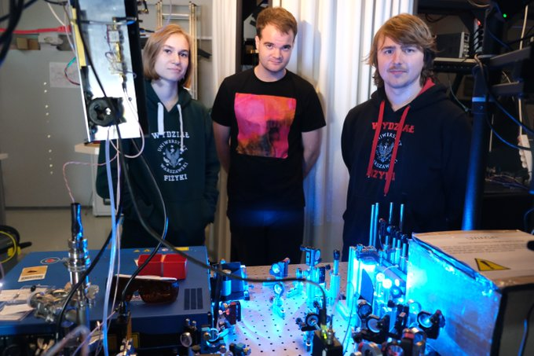
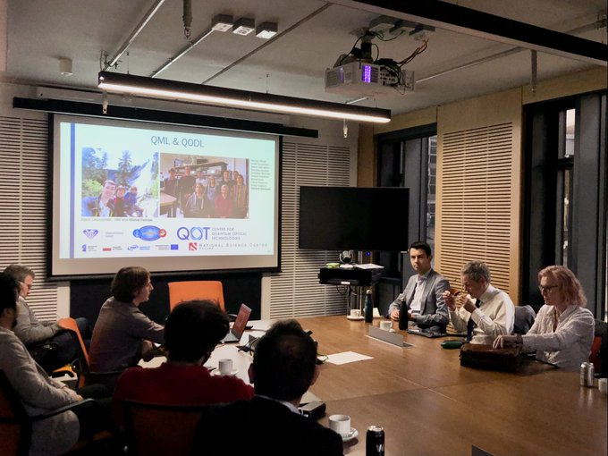
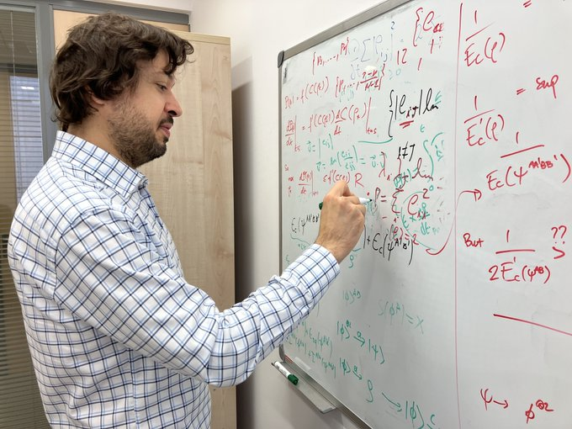
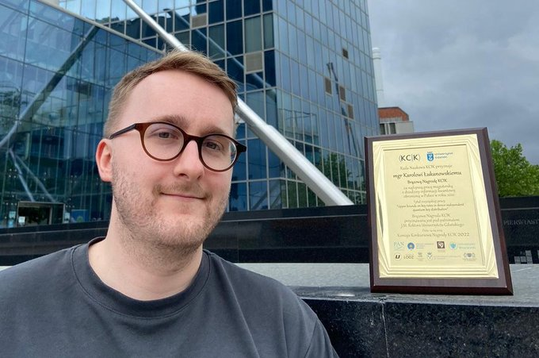
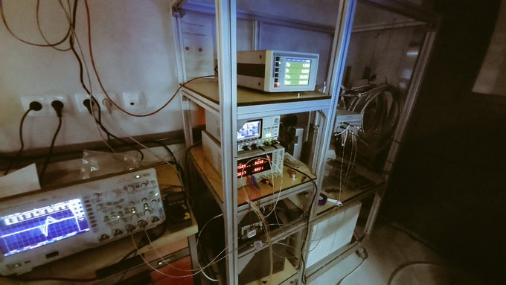
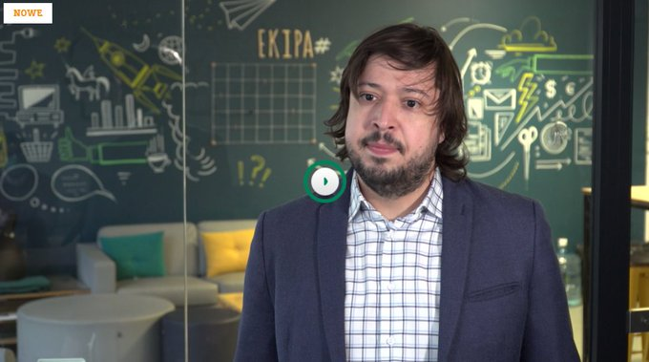
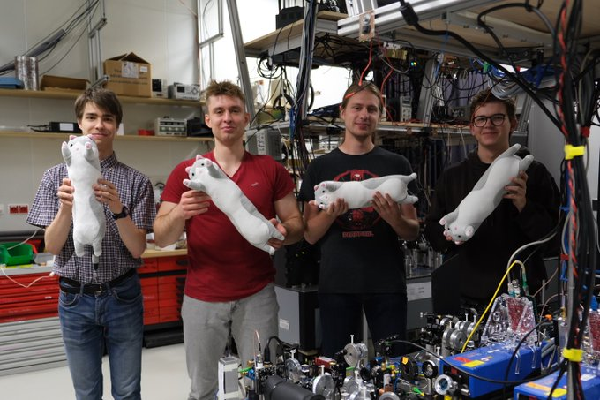
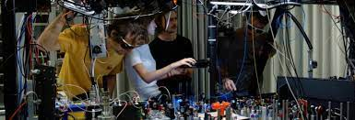
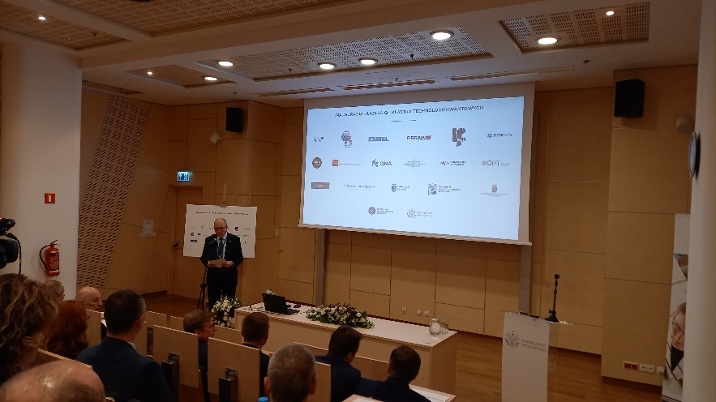
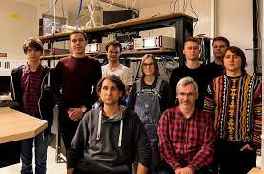
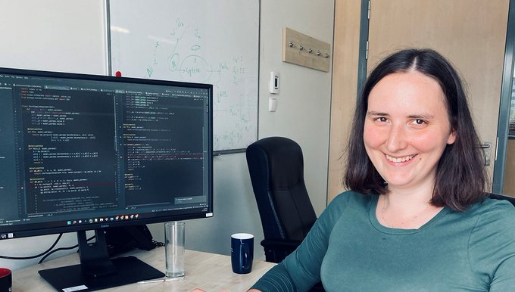
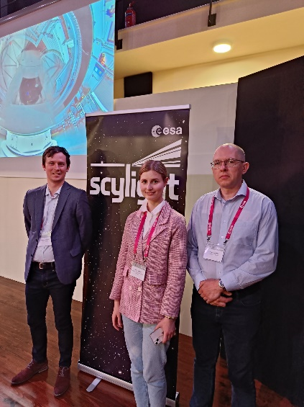
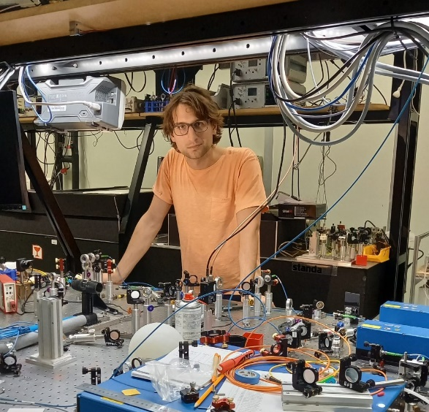
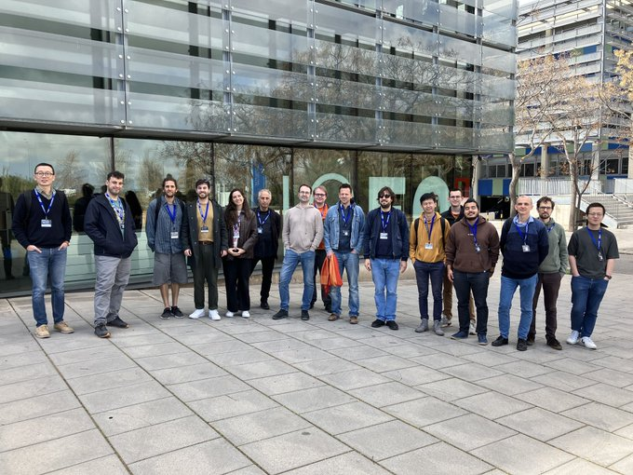
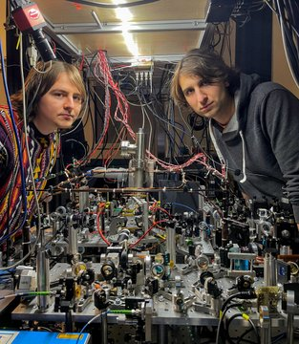
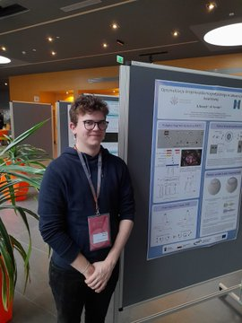

Slide 5
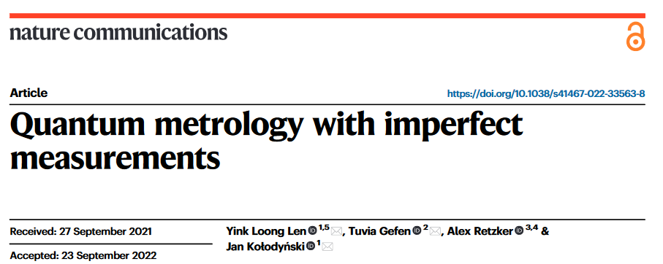
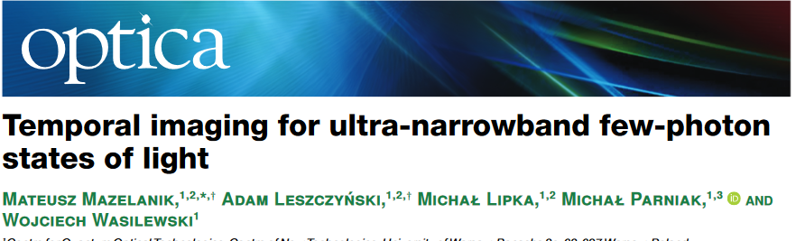
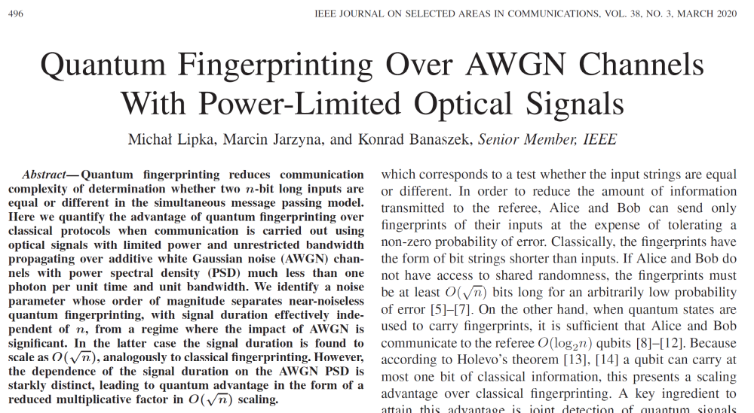

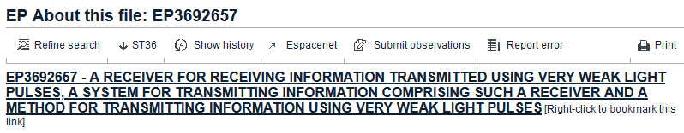
Realistic quantum technologies @QOT
Quantum metrology and sensing
Quantum imaging
Quantum and optical communications

Slide 6


The idea of QOT
Practical implementation of ideas
New technologies, innovations, industry applications
Groundbreaking
fundamental
science
Innovation brings progres in science itself

Slide 7
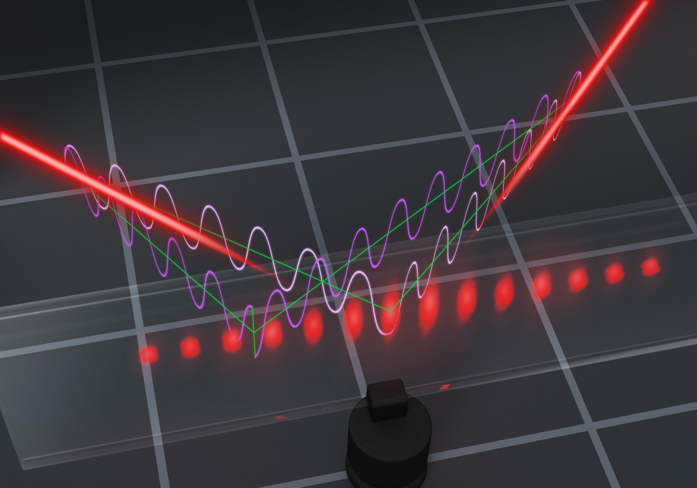
Quantum metrology
Notes:
Atoms are a versatile medium in which we can store, process, and finally read-out light. By performing maniupulation of stored light, we may achieve operations which are precise down to the level of single photons, in a stark contrast to any electronic processing in modern networks.

Slide 8
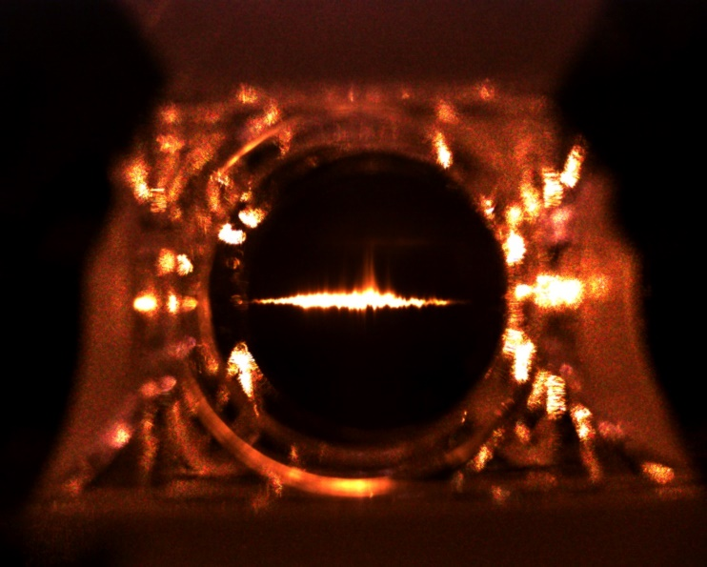
Atomic control for quantum information processing
Notes:
Atoms are a versatile medium in which we can store, process, and finally read-out light. By performing maniupulation of stored light, we may achieve operations which are precise down to the level of single photons, in a stark contrast to any electronic processing in modern networks.

Slide 9
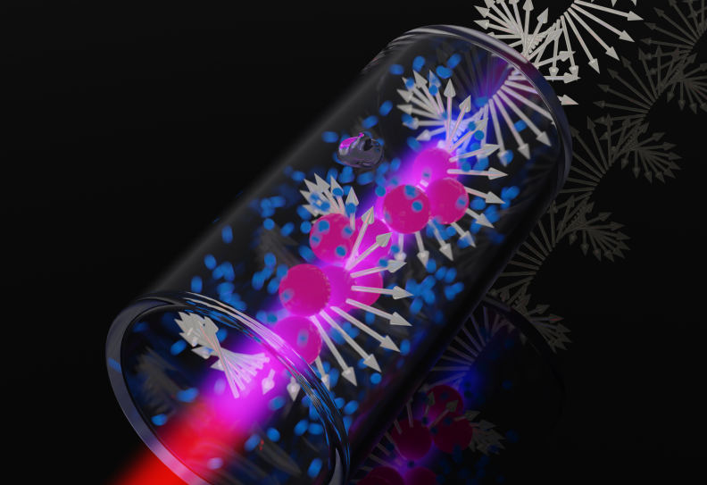
Rydberg atoms
Notes:
The IRA programme allowed us to enter a new topic of Rybderg physics. With immediate applications in mind, we decided to use hot Rydberg-atom vapor for quantum transduction.

Slide 10
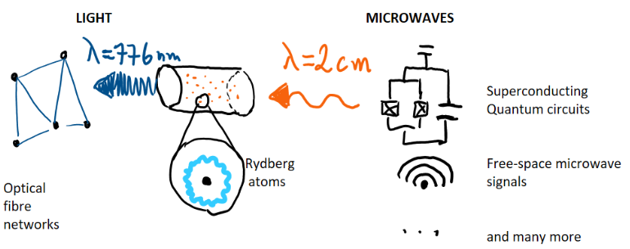
End goal: quantum networking with quantum transduction
Notes:
Applications of quantum transduction stretch from very far-fetched ones related to linking quantum computers (we’re not there yet), through THz imaging first explored recently by a UK group from Durham, and finally sensing and communication with extrementally weak microwave and terhertz fields. This ties in directly to modern communication networks which have a hybrid character of using both optics, microwaves and mm-waves.

Slide 11

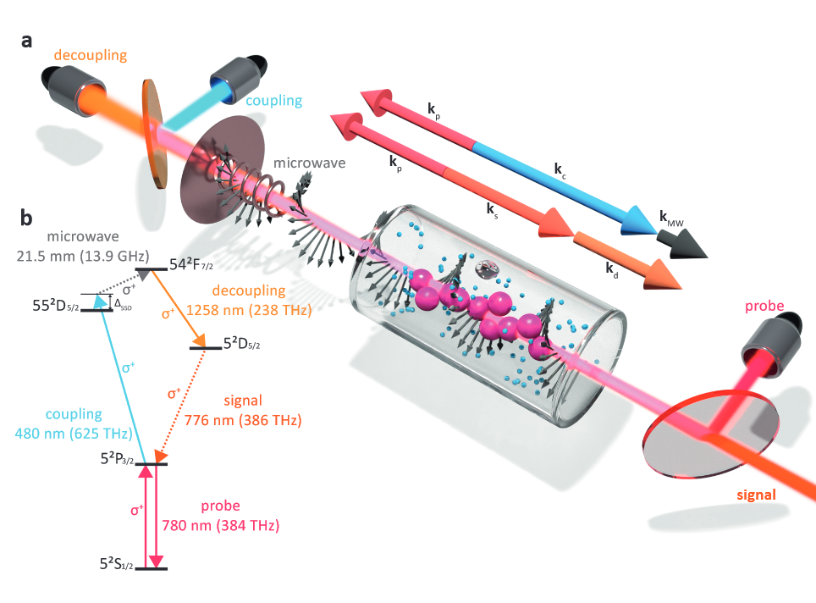
Microwave-to-optical conversion
Also supported by SONATA grant
Notes:
Applications of quantum transduction stretch from very far-fetched ones related to linking quantum computers (we’re not there yet), through THz imaging first explored recently by a UK group from Durham, and finally sensing and communication with extrementally weak microwave and terhertz fields. This ties in directly to modern communication networks which have a hybrid character of using both optics, microwaves and mm-waves.

Slide 12
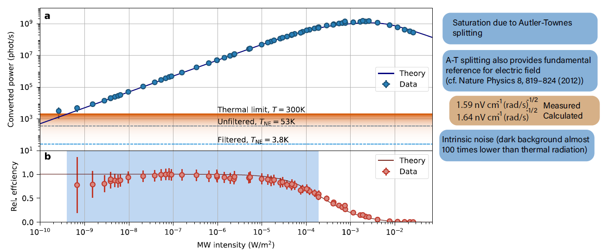
Photon counting and efficiency
S. Borówka et al.,
Nature Photonics (2023),
arXiv:2302.08380
Notes:
Impressievly, our device operates over six orders of magnitude and allows for direct Photon-counting, background-free observation of room-temperature radiation. Callibration is intrinsic and SI-traceable thanks to fundamental atomic properties, which we confirmed with excellent precission comparing against expected thermal noise.

Slide 13
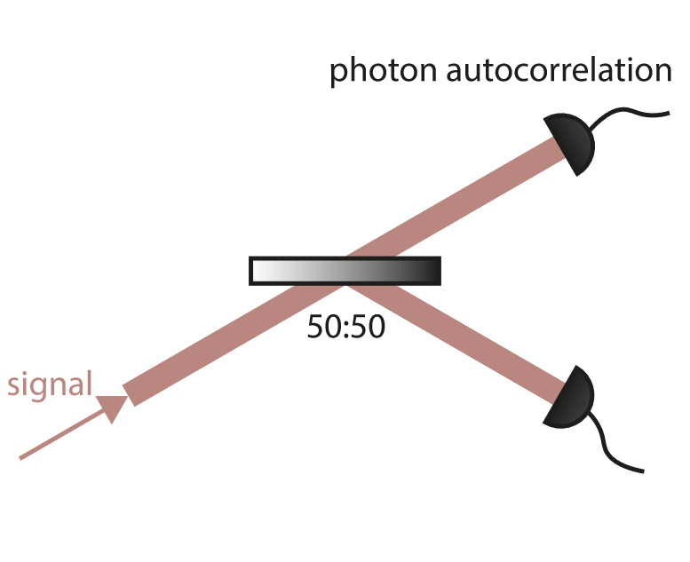
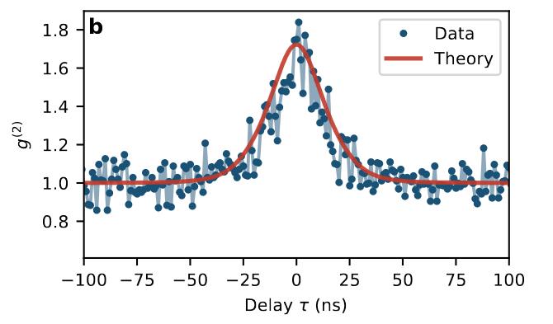
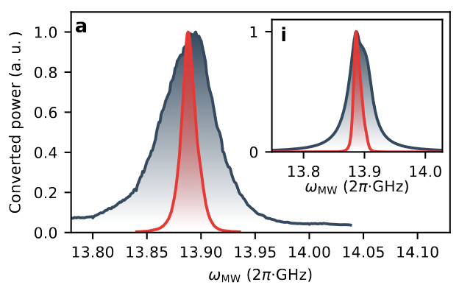
Photon statistics and tunability
Tunable bandwidth (single laser)
Instantenous bandwidth
S. Borówka et al.,
Nature Photonics (2023),
arXiv:2302.08380
Notes:
We confirm our noise properties by obseveration of bunching of thermal microwave photons on our detectectors, which is a hallmark of thermality of the radiation.

Slide 14
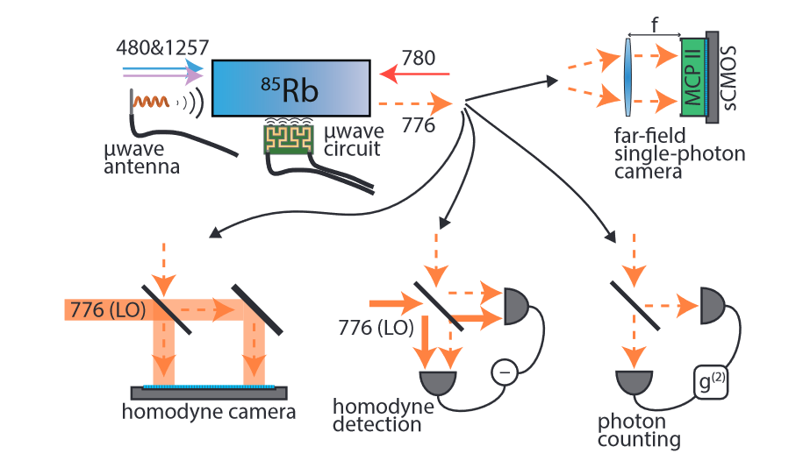
Next applications of our quantum transducer
Key properties:
Large bandwidth
CW capability
Room temperature operation
Notes:
We expect to use our scheme for imaging of microwave to THz waves in various novel scenarios with unprecedented technical paramters of noise and efficiency.

Slide 15
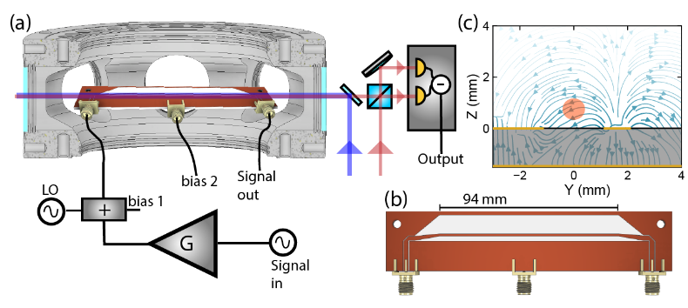
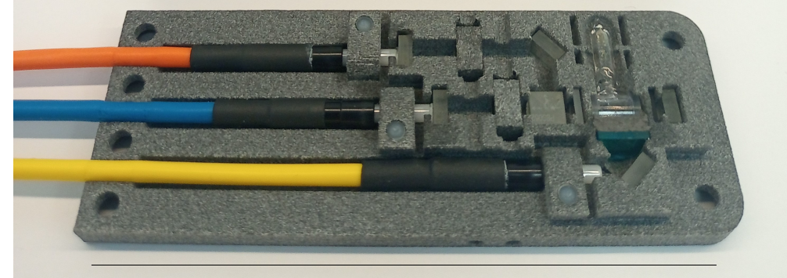
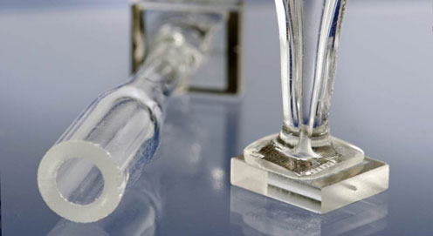
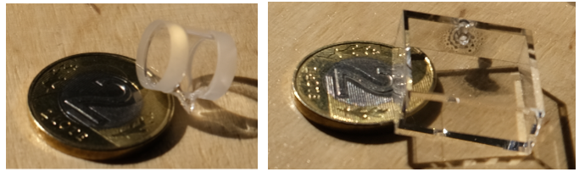
Towards practical devices: cells and waveguides
Future: all-fiber laser system?
Waveguided device
Future: miniaturized assembly
Soon: smaller cel
Potential: all-glass/fiber/plastic microwave receiver, insensitive to EMI
Notes:
Future systems will become miniaturized, circuit-based and ready for applications in rought environments.

Slide 16
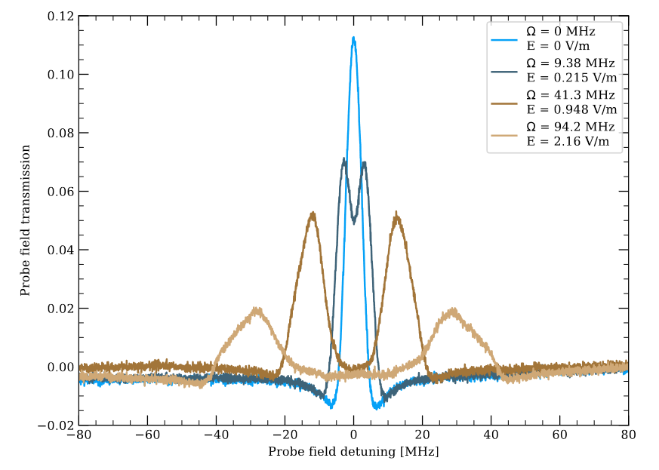
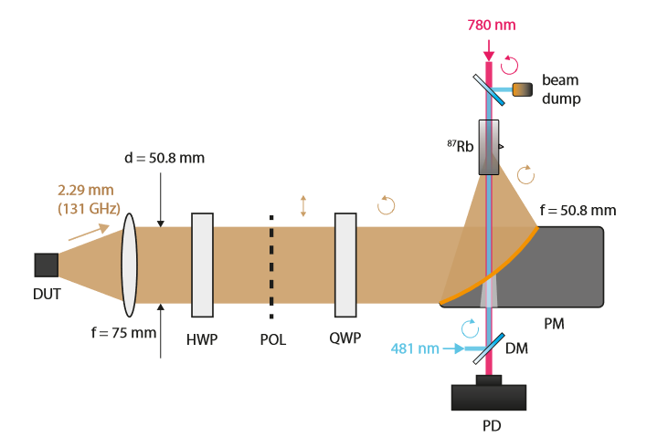
Callibration of a chip source for automotive applications (TRA120)
S. Borówka, W. Krokosz, M. Mazelanik, W. Wasilewski, M. Parniak, Phys. Rev. Applied 22, 034067

Slide 17
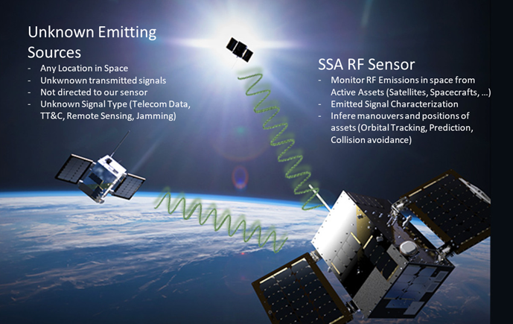
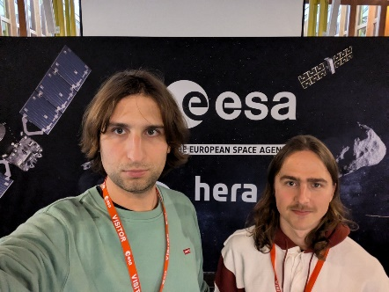
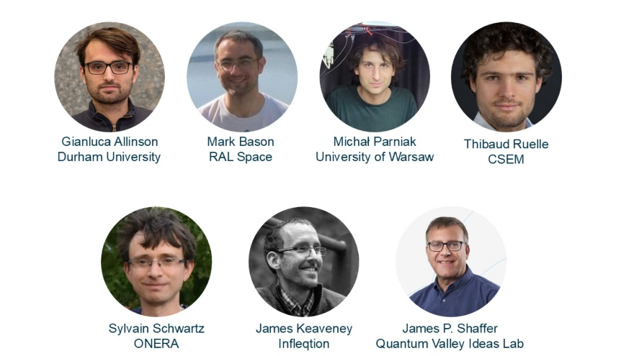
Rydberg atoms in space?
Rydberg Community Workshop at ESA
November 2024

Slide 18





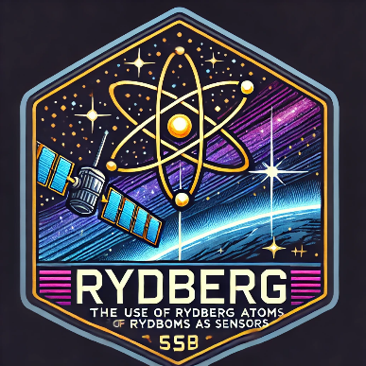
Sensor for the European Space Agency
Prototype breadboard development
600k€
1.5 years
Main contractor: UWRC – University of Warsaw special purpose vehicle company
Industrial partner: Thales Allenia Space Italia

Slide 19
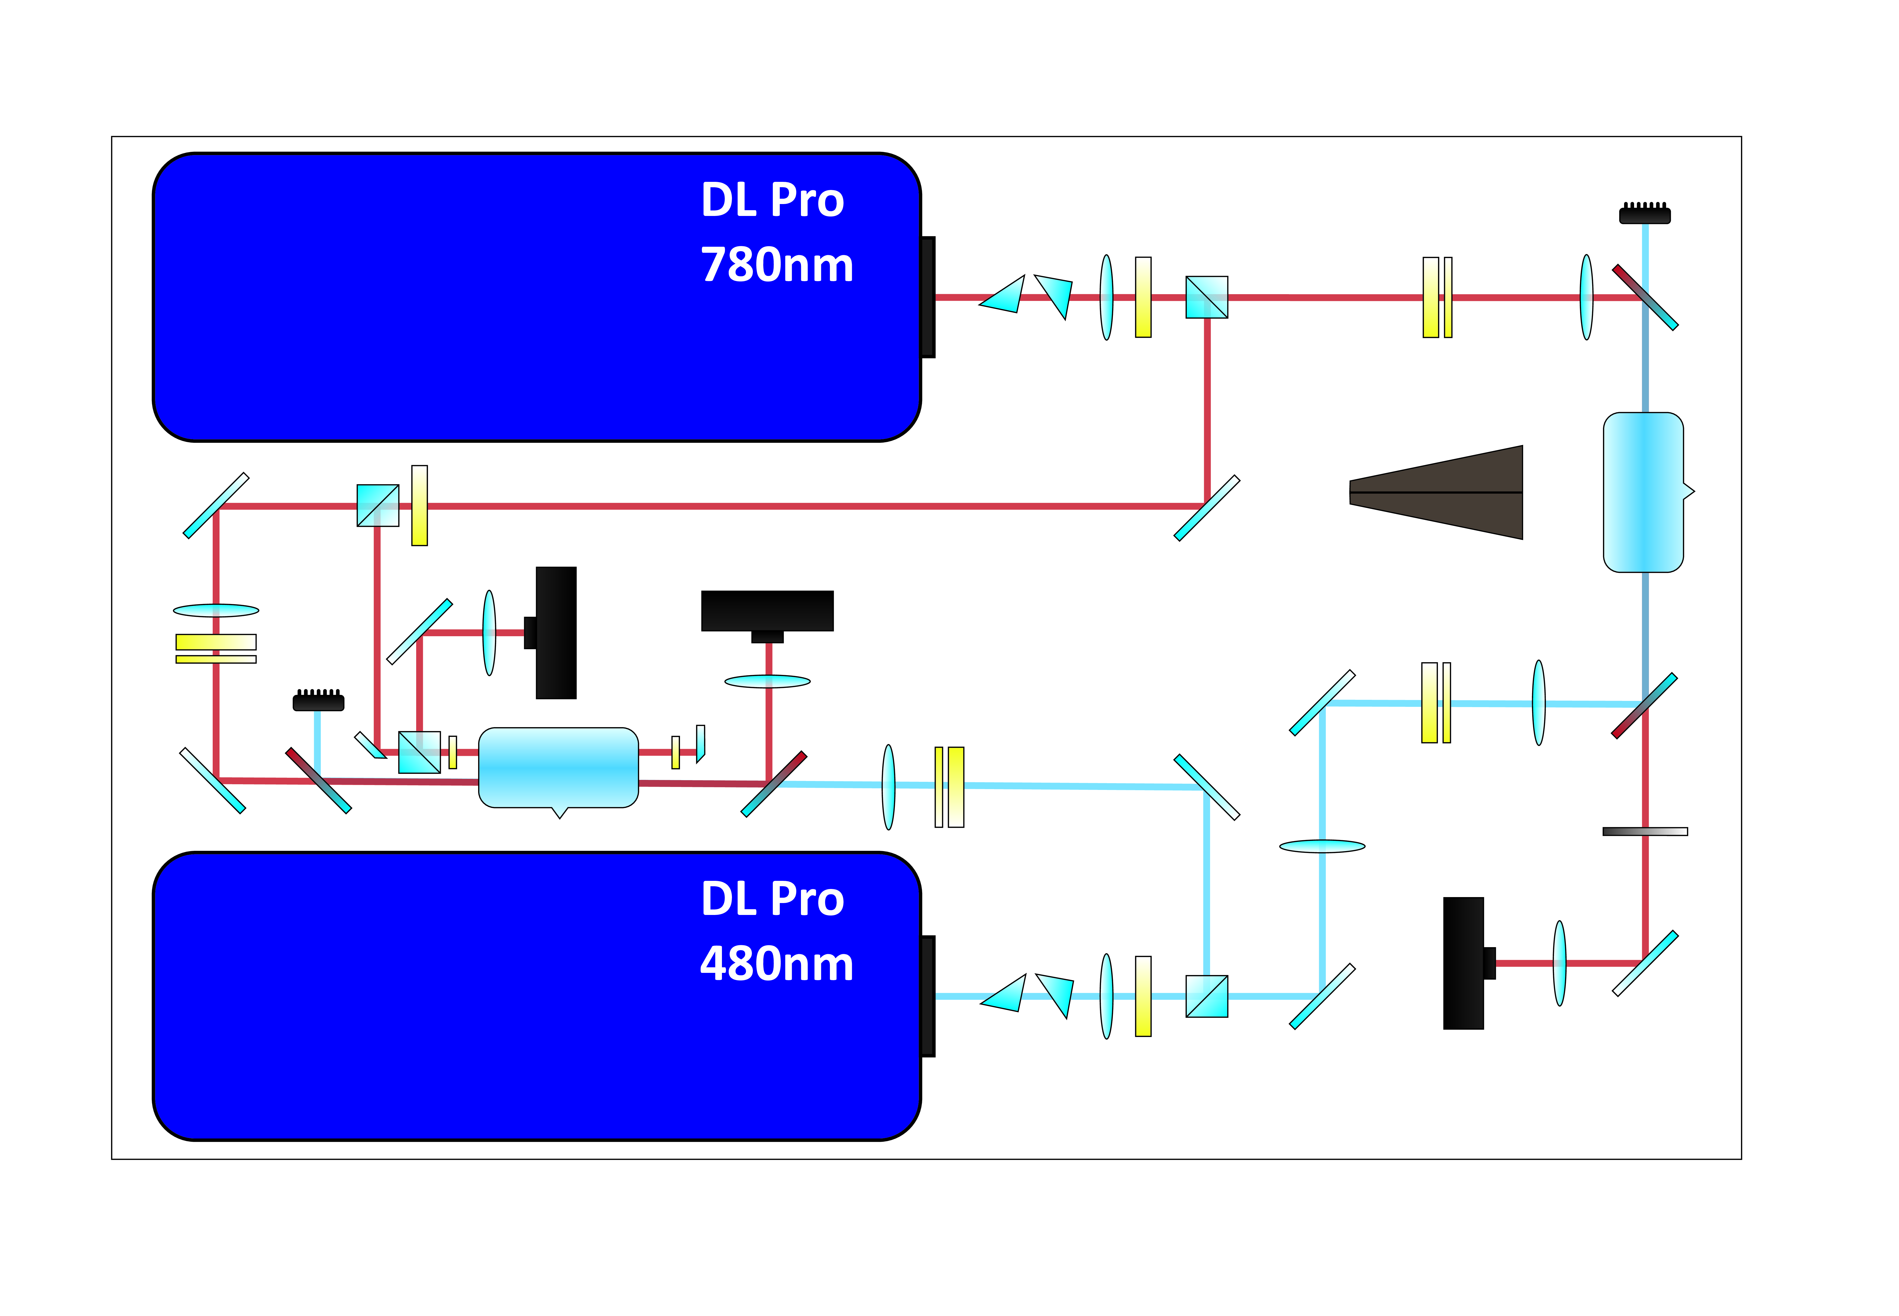
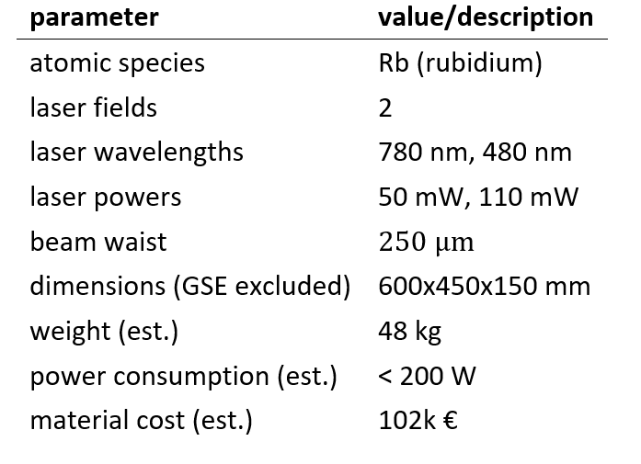
Prototype Specifications (TRL 3 -> TRL 4)

Slide 20
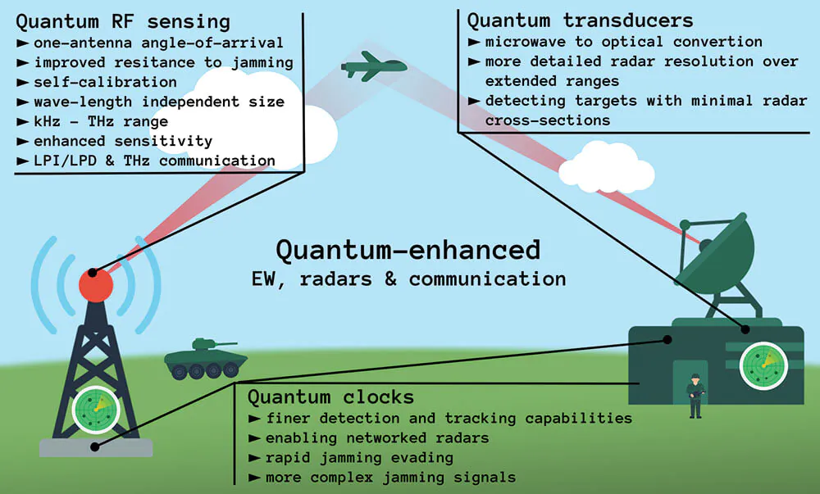
Rydberg (passive) radars
https://www.japcc.org/

Slide 21
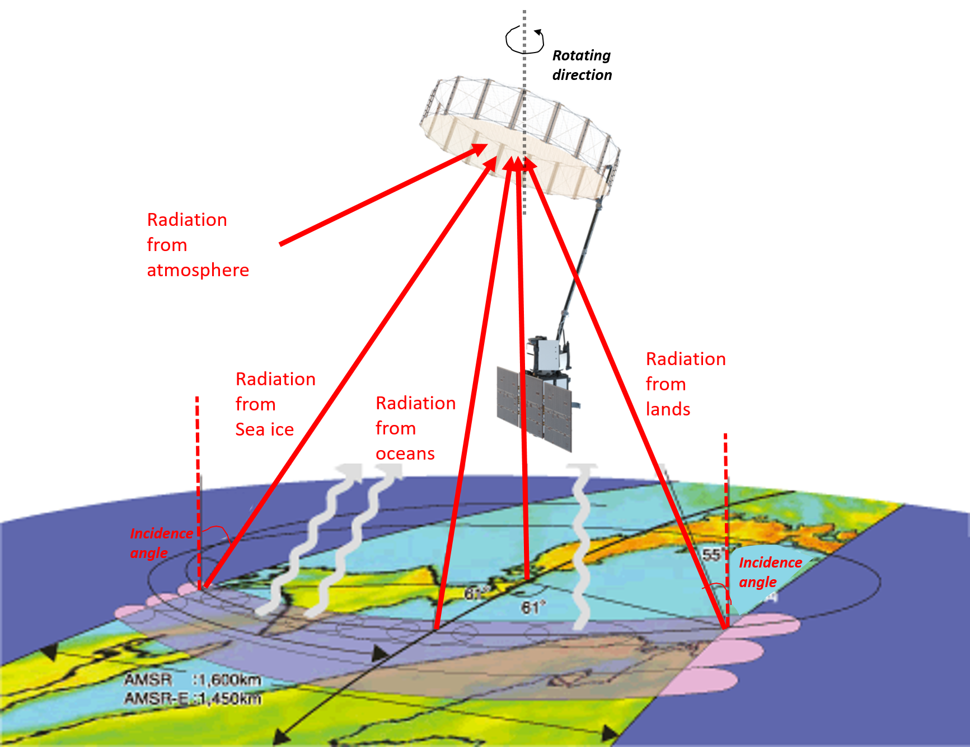
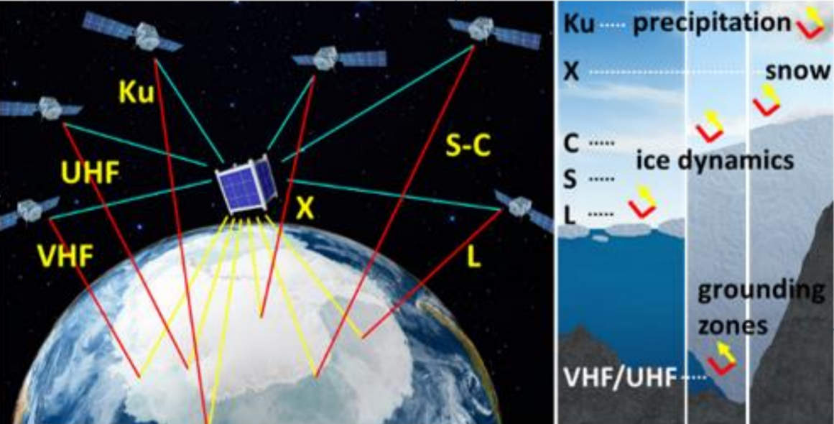
Application in Radiometry
Cryosphere Rydberg Radar
(project at NASA)

Slide 22
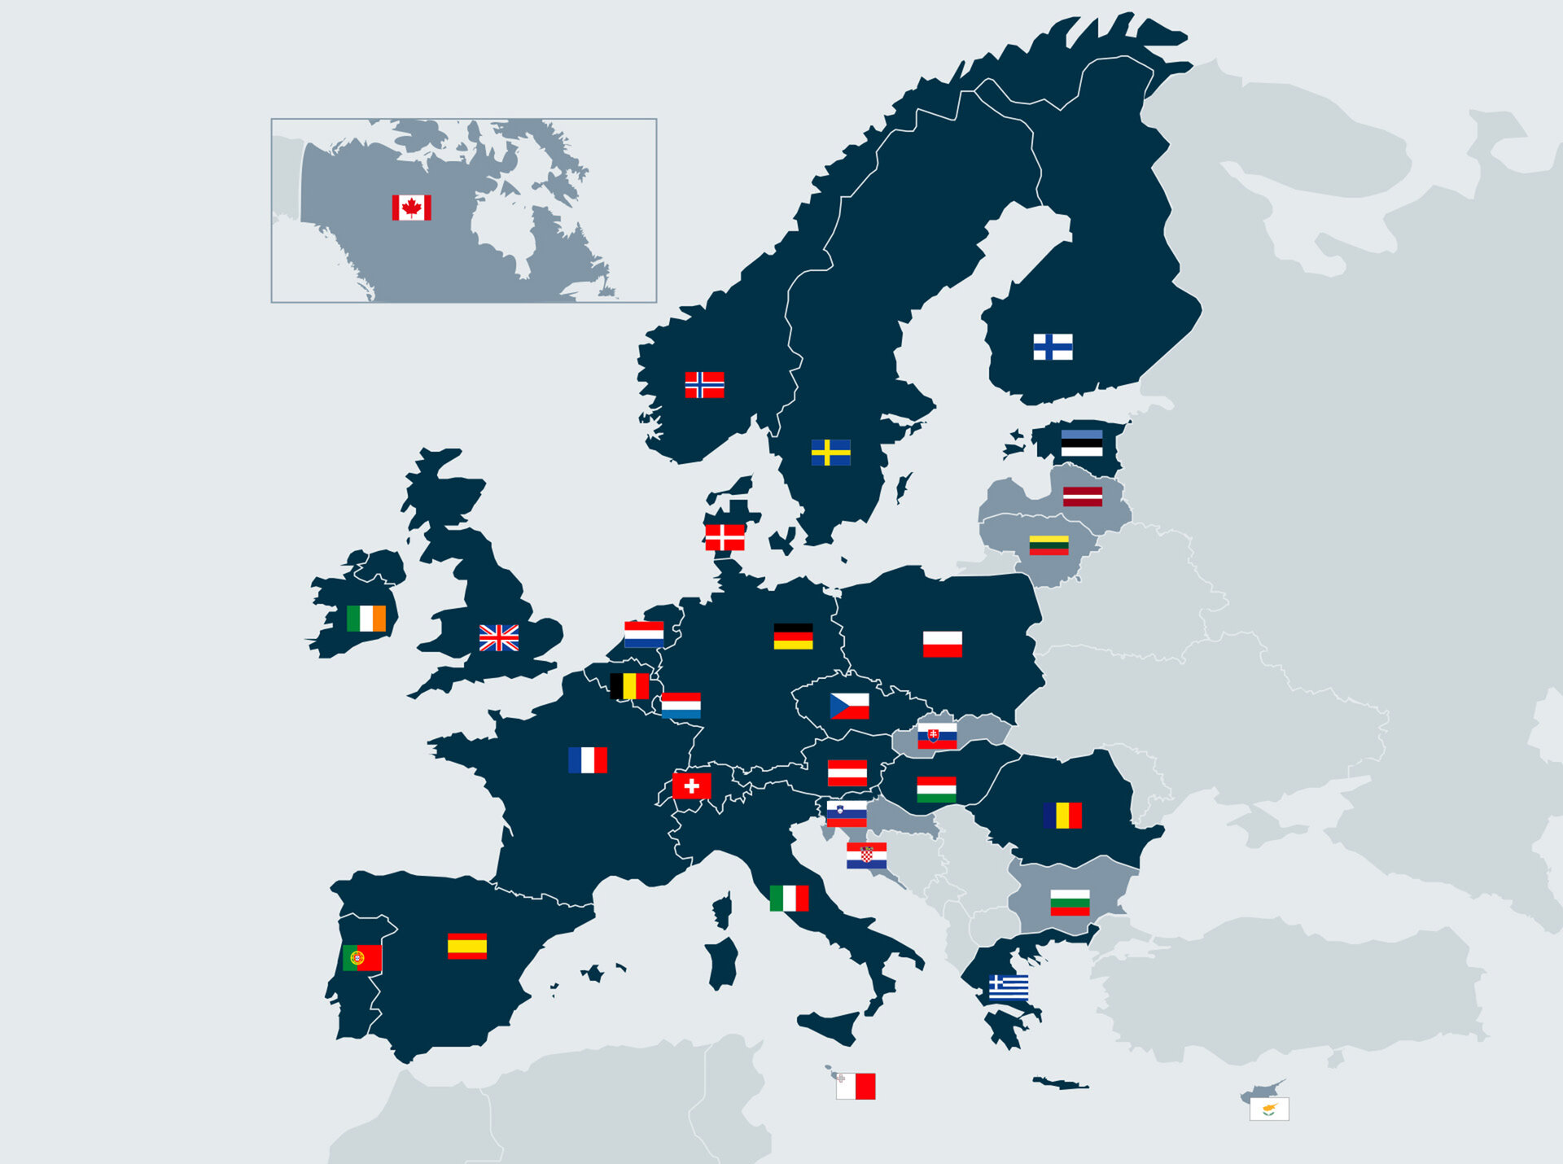
Upcoming Rydberg whitepaper
Quantum Valley
Ideas Lab
Univ. of Durham
British Telecom
ESA ESTEC
UW/UWRC
CSEM
ONERA
Thales Allenia Space
Univ. of Bari

Slide 23
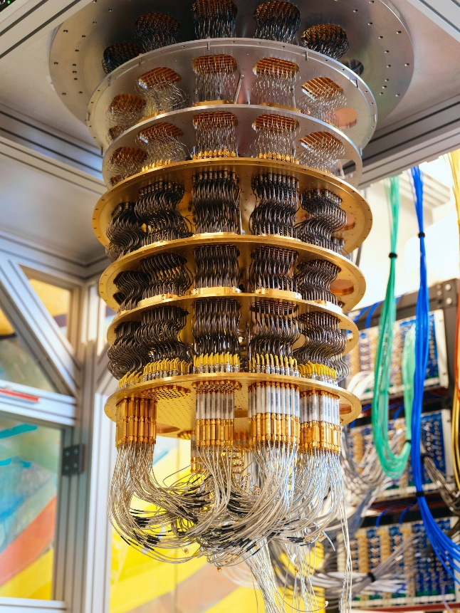
What about Quantum Computing?
Our approach: use atoms!
A technology we use, develop and control
This is just a very expensive refrigerator ;)
Many kW power consumption

Slide 24
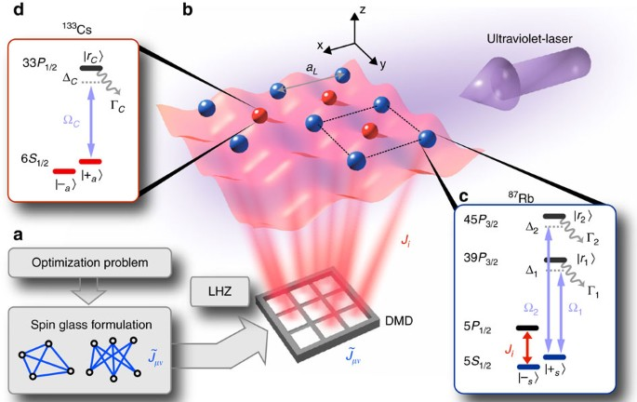
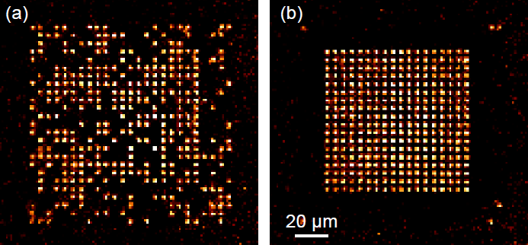
Towards quantum computer of our design
Nature Communications volume 8,15813 (2017)
https://atom-tweezers-io.org/news-archive/
Atom Computing, Quera (USA), Pasqal (France – now our collaborators in a Q-PLANET JU Chips action)
Notes:
You can rearrange them and create quantum chips.

Slide 25

General architecture

Slide 26



Our qubits – now operational
Notes:
And so far we have made progres and we already can generate atomic rydberg qubits in our lab in Warsaw.

Slide 27



Thank you
Dziękuję za uwagę
2024-2029
FENG.02.01-IP.05-0017/23
Notes:
Many of the results have been based on our patent-pending laser locks. Our locking scheme is more compact and less fragile, with much room for further miniaturization.

