Slide 1
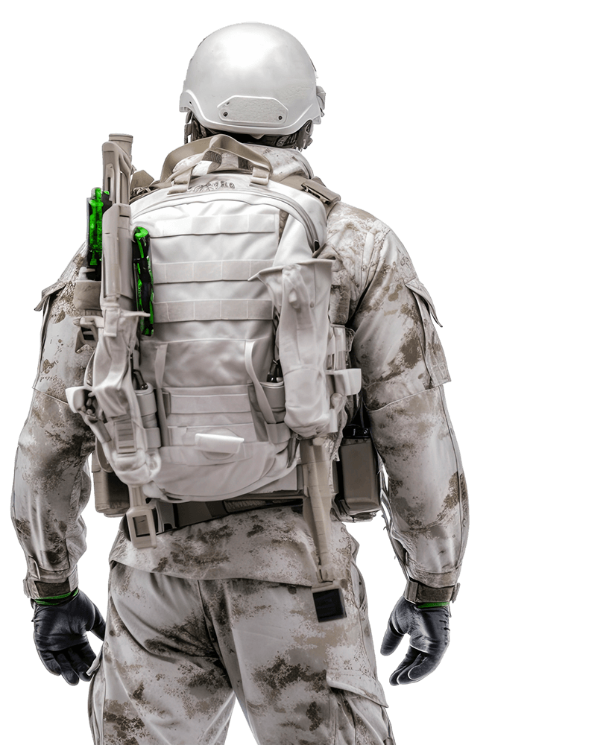

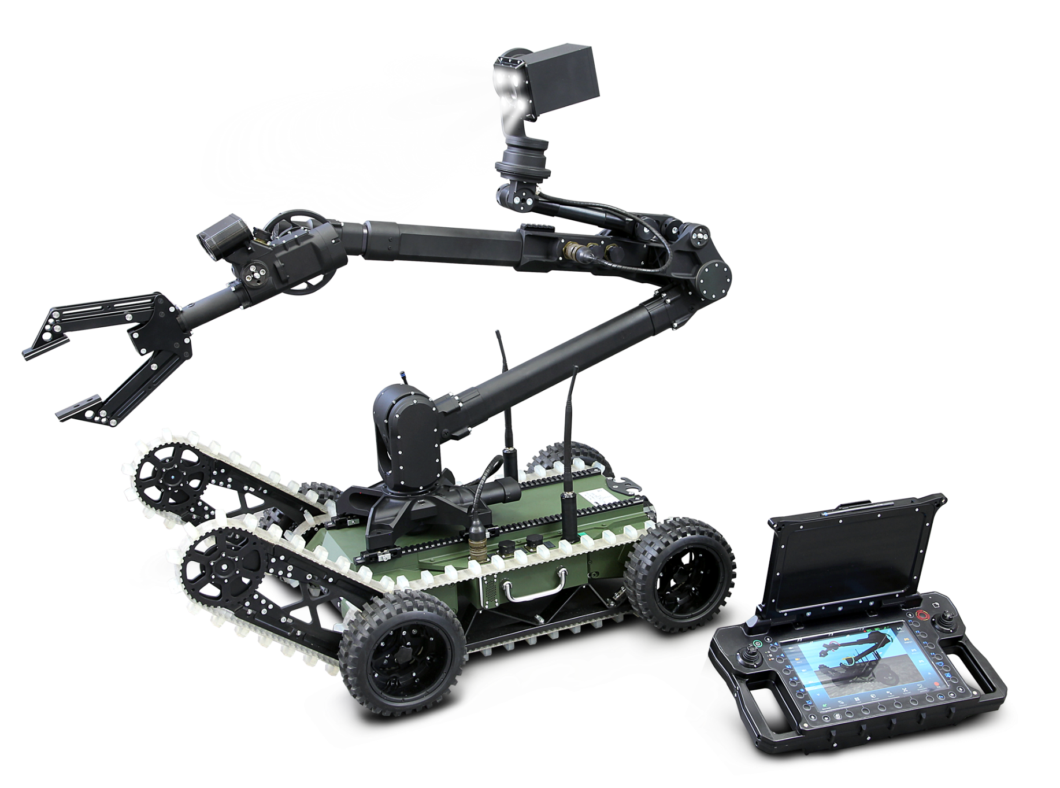
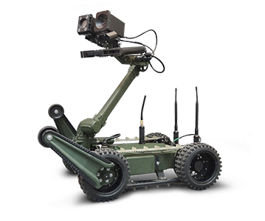
Showcase of success stories
Experience and competence in the field of mobile robotics and security solutions
National Knowledge Valorisation Day, 26 -27 May 2025

Slide 2
Łukasiewicz – PIAP
ABOUT US
60 years
of experience in automation and robotics
250
employees
Łukasiewicz Research Network - Industrial Research Institute for Automation and Measurements PIAP
Established in 1965
Part of Łukasiewicz Research Network (22 R&D institutes)
First mobile robots manufacturer in Poland (INSPECTOR, 1999)
25 years experience in EOD robotics
We specialize in:
  mobile robotics solutions for public safety
  Equippment dedicated for the Army, Police and antiterrorist agencies.
25 years
in EOD robotics
> 600
robots deployed

Slide 3
Certificates
Łukasiewicz - PIAP
ISO
9001:2015
Internal Inspection System
NATO N-CAGE
NATO, ESA, UE
certificates
AQAP
2110:2016
NATO SECURITY CLEARENCE

Slide 4
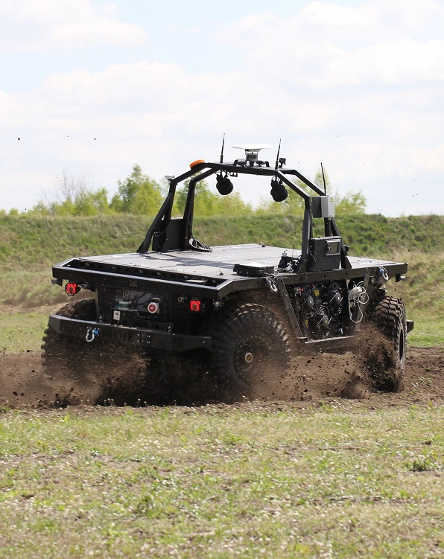
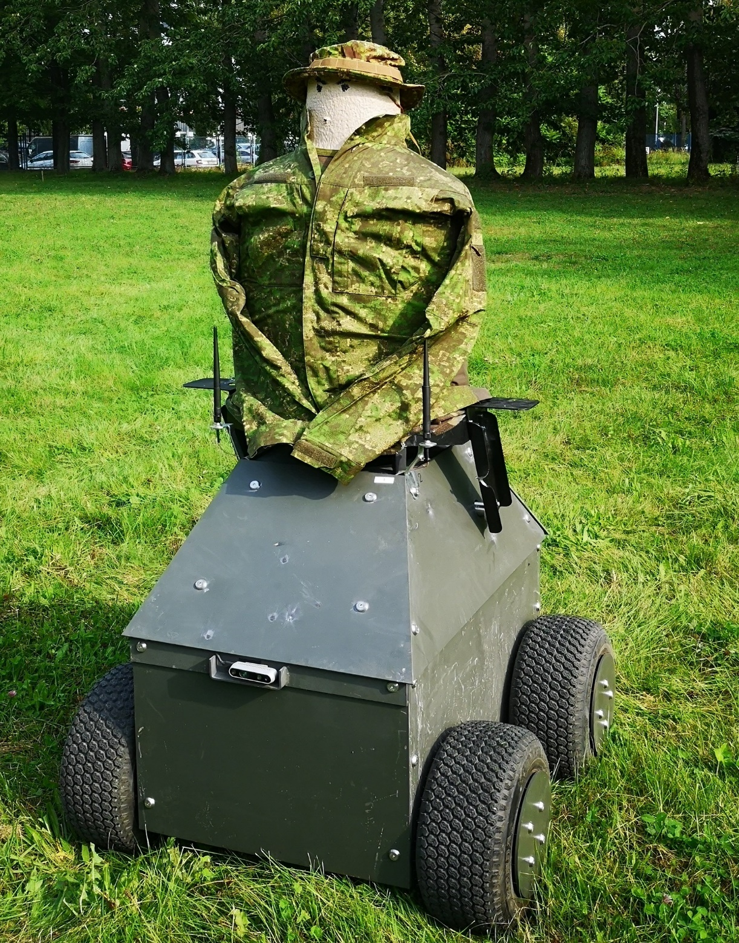
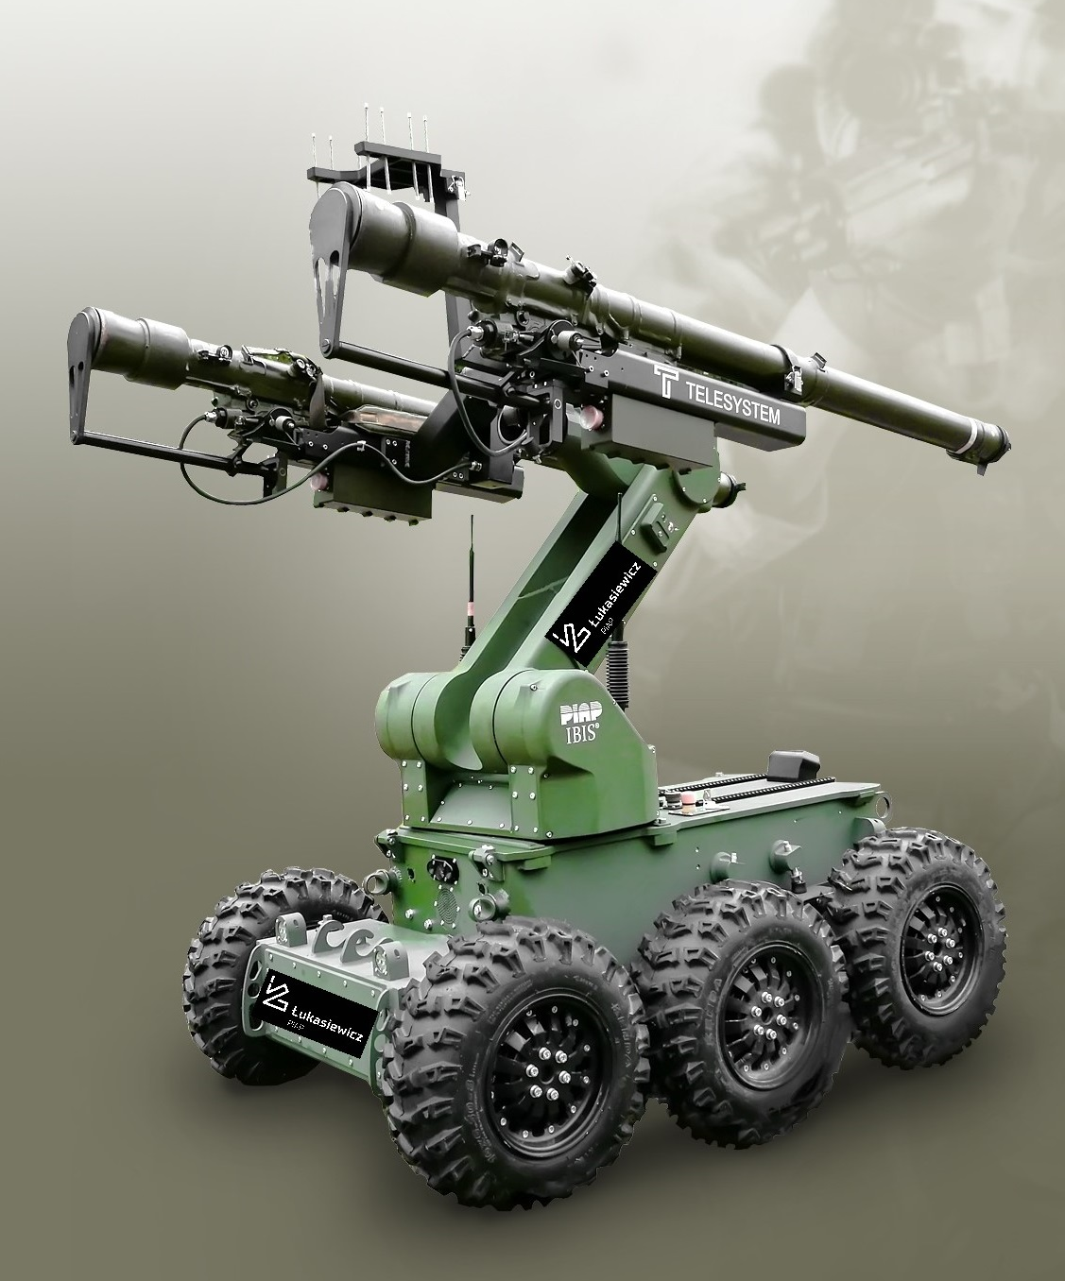
INNOVATIVE SOLUTIONS FOR Defence & Security

Slide 5
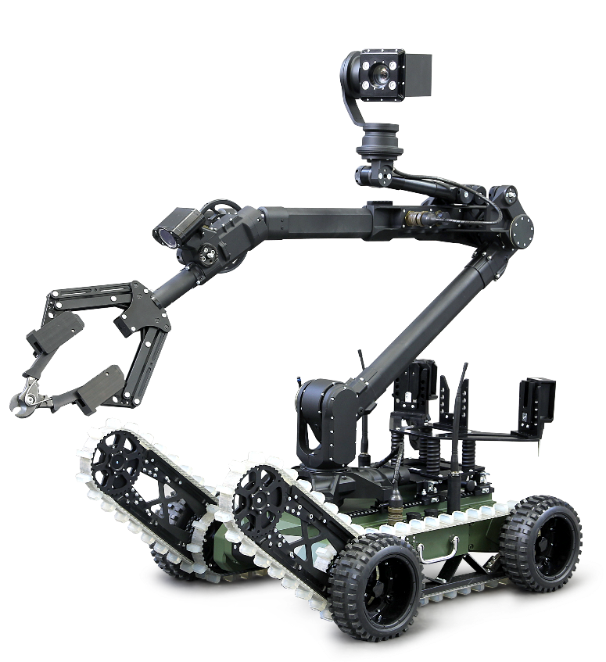
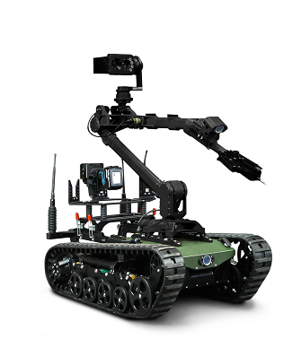
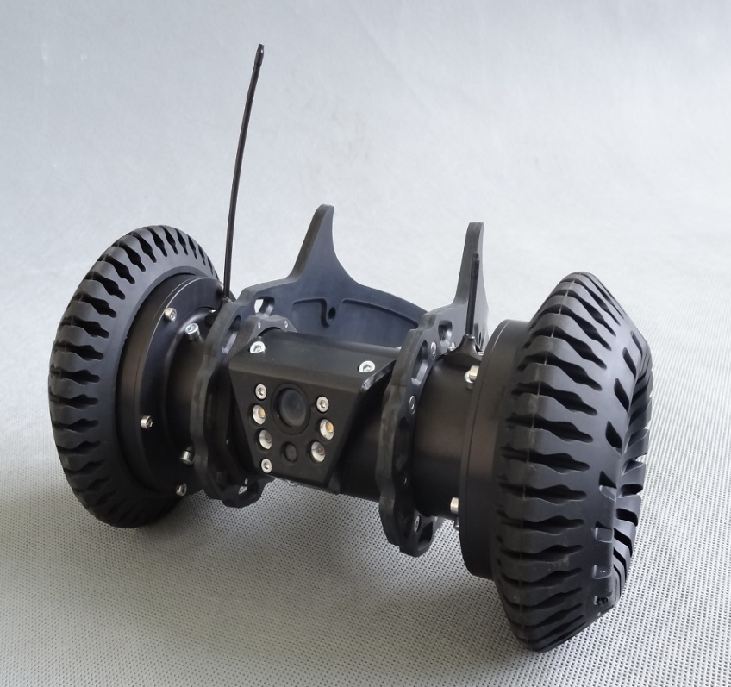
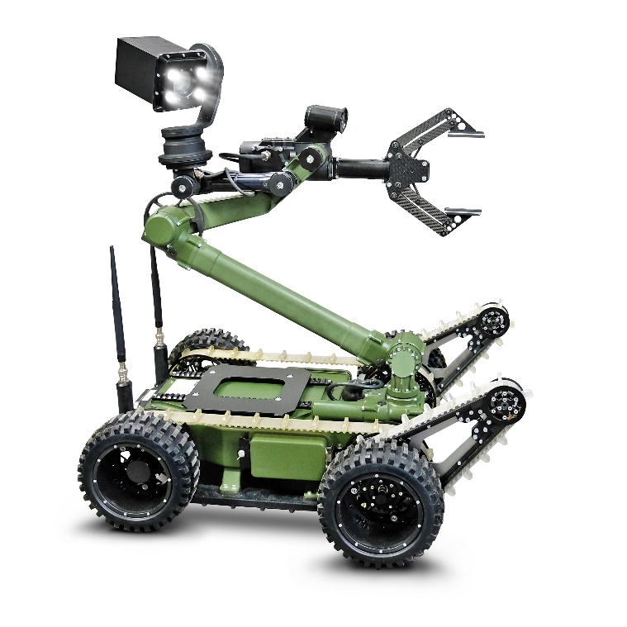
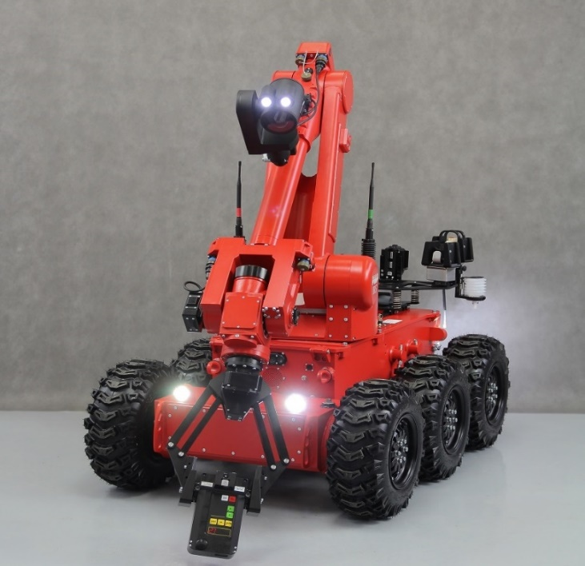
MOBILE ROBOTS
The challenges faced by the services responsible for public security and national defense
in the 21st century require the use of innovative solutions that integrate the latest available technologies
PIAP TRM ®
Tactical Throwable Robot
PIAP FENIX ®
Light robot for recognition and neutralization of EOD
PIAP GRYF ®
A mobile pyrotechnic robot
PIAP PATROL ®
Intervention mobile robot for C-IED and CBRN tasks
PIAP IBIS ®
A large robot for pyrotechnics and reconnaissance

Slide 6
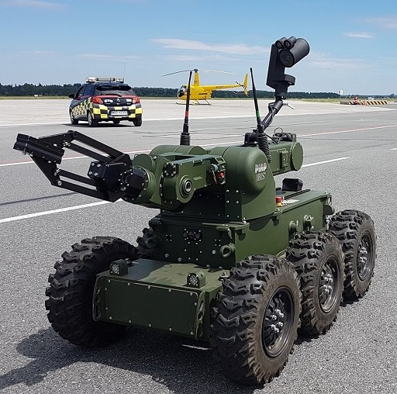
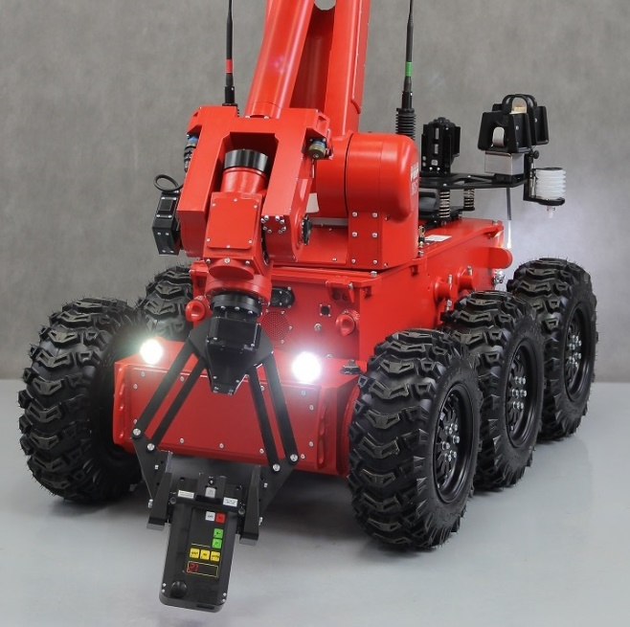
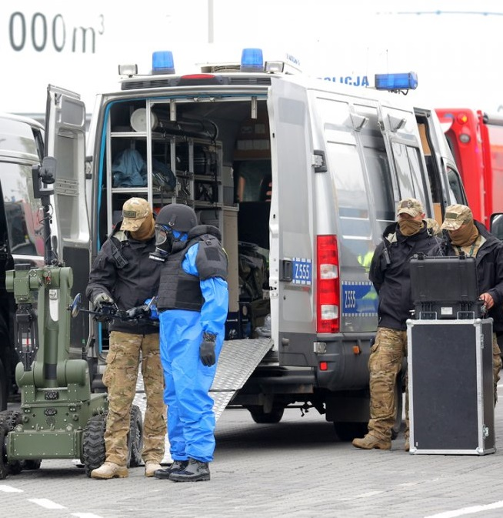
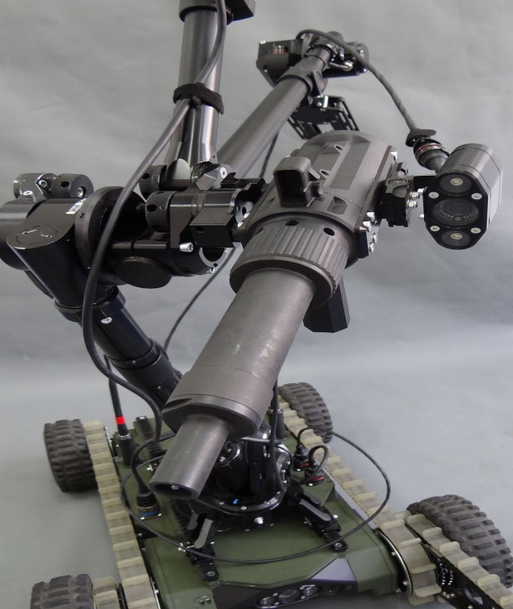
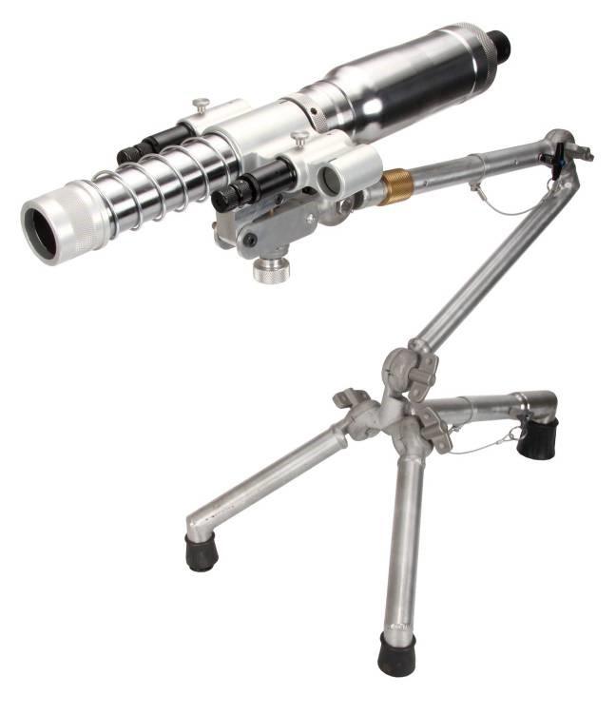
defense and security
Our many years of experience and a wide network of partners allow us to build and implement complex system solutions in the area of security.
Mobile robots
CBRNE accessories
Special vehicles
PIAP special equipment
EOD accessories (disruptors,
x-rays…)

Slide 7


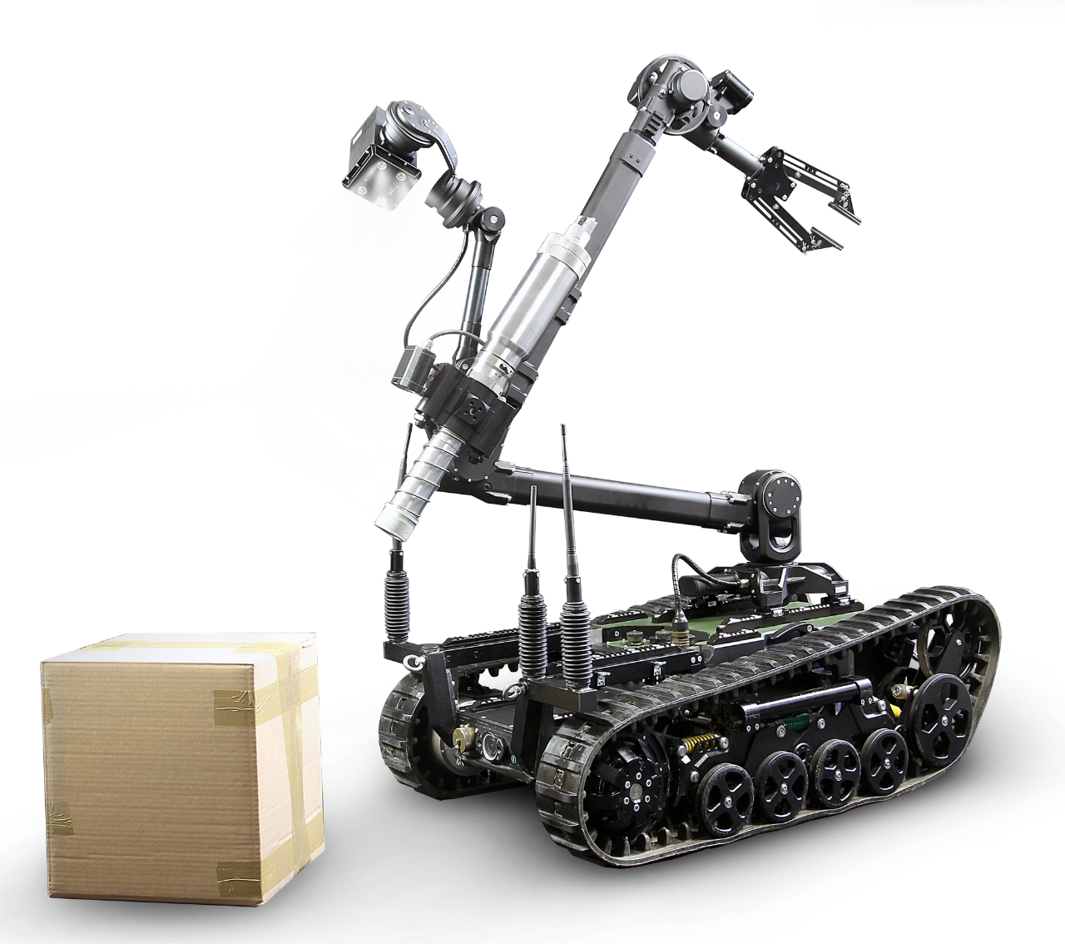
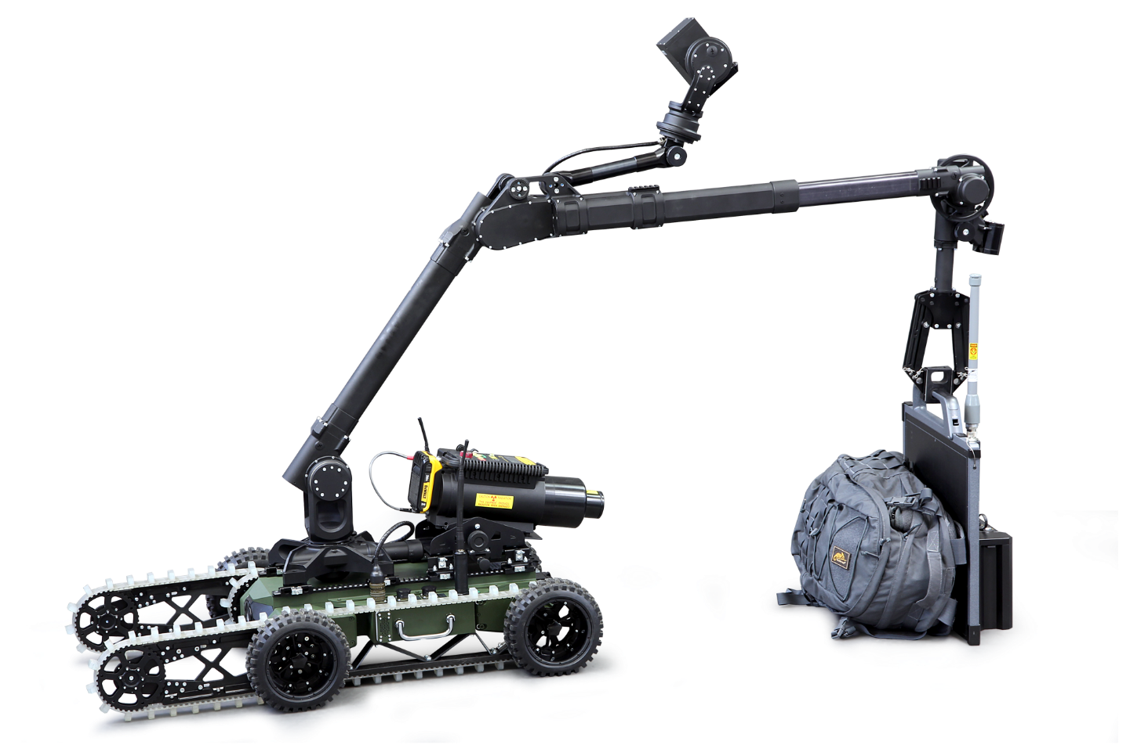

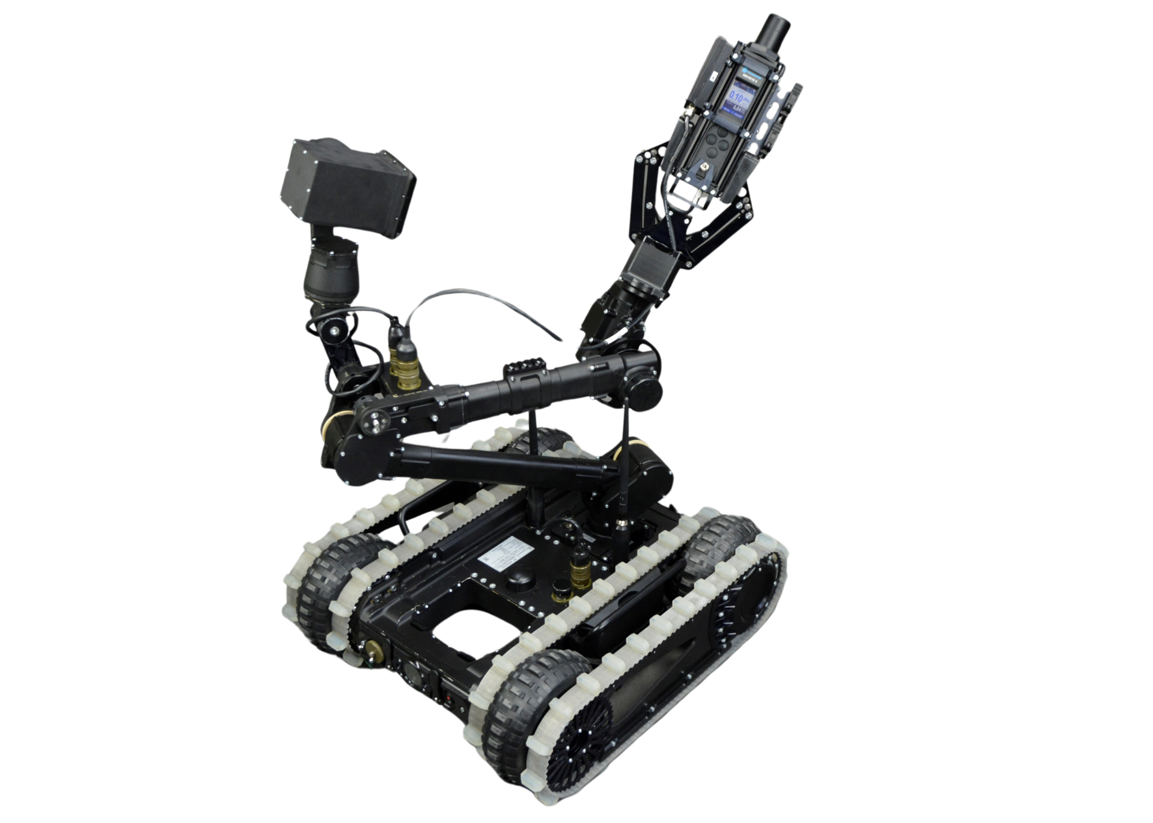




fully integrated Systems
RECOILLESS DISRUPTORS
MOBILE X-RAY SYSTEM
RECOILLESS DIRUPTORS
RADIATION DETECTOR PM1401K
BENELLI Shotguns

Slide 8









Ł – PIAP partners
Richmond Defence Systems (UK)
Logos Imaging LLC (USA)
FOG GmbH (Germany)
Global Clearance Solutions GCS AG ( Switzerland)
Polimaster Europe UAB (Lithaunia)
PT Merpati Wahana Raya (Indonesia)
AREX Sp. Z o.o. WB Group (Poland)
JAKUSZ Sp z o.o. (Poland)
Direct Action Gear (Poland)

Slide 9
Łukasiewicz – PIAP
In the world
Present in
28
markets
Korea
Seoul SHOWROOM
Current main export markets:
    Saudi Arabia
    South Korea
    Nigeria
    Vietnam
    Indonesia
    Pakistan
    Senegal
    Togo
    France
    Romania
    UAE
    Finland

Slide 10

THANK YOU FOR YOUR ATTENTION
Łukasiewicz – PIAP
www.antiterrorism.eu

