Slide 1




NOMATEN: Centre of Excellence in Multifunctional Materials for Industrial and Medical Applications
NOMATEN Project
Jacek Jagielski

Slide 2
Aims
The overall aim of the NOMATEN project is to create a Centre of Excellence (CoE) in Multifunctional Materials for Industrial and Medical Applications
The success and long-term sustainability of the NOMATEN CoE will be based on:
  Strategic Research and Innovation Agenda focused on two interdisciplinary topics:
  (i) novel materials resistant to harsh environments and
  (ii) novel radiopharmaceuticals for medical applications, which both are aligned with the Smart Specialization of Poland and address strategic priorities of the EU.
  Organization structure positioning the CoE as a “game changing” research entity in Poland with truly international approach and innovative governance and management principles based on the best practices of international partners.
  Customer-centric business model making the CoE a focal point for collaboration between the research community, industry and government and ensuring its financial viability.

Slide 3
Aims
Nuclear materials
High Temperature
Irradiation
Chemistry
Power
Corrosion
Radiopharmaceuticals

Slide 4
Structure
ISC
NOMATEN
Centre of Excellence
Director: prof. Łukasz Kurpaska
SC
Organization
NOMATEN
Support Projects (MAB+, MN)
Coordinator: prof. Łukasz Kurpaska
NOMATEN
TEAMING Project
Coordinator: prof. Jacek Jagielski
Research grant
Coordination and Support Action
ISC
GA
PMB
NOMATEN CoE is an independent Department in parent institution, NCBJ

Slide 5
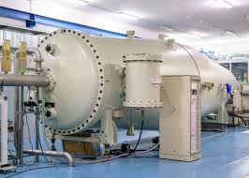
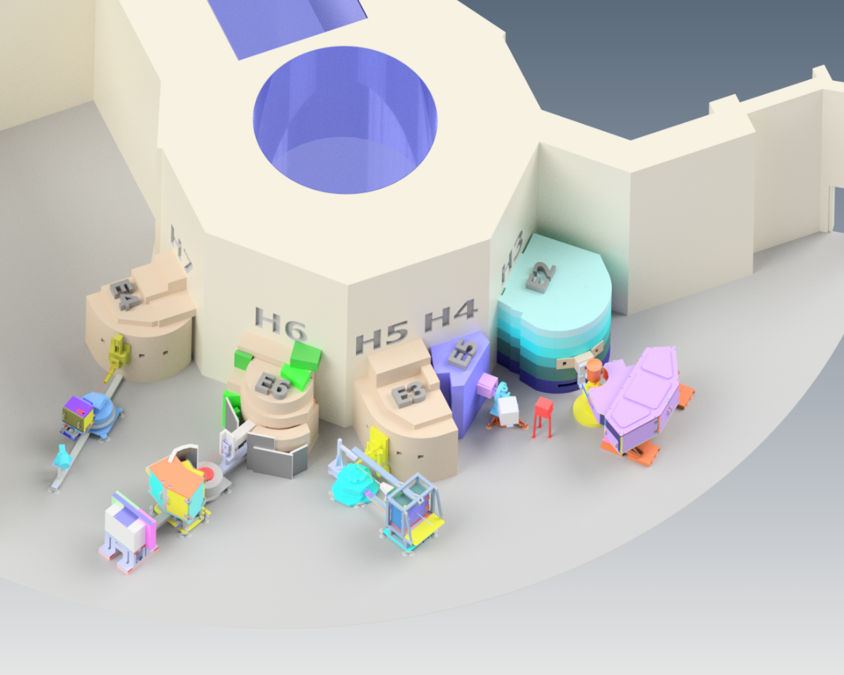
Current status
Research Groups:
COMPLEXITY IN FUNCTIONAL MATERIALS
FUNCTIONAL PROPERTIES
MATERIALS CHARACTERIZATION
MATERIALS STRUCTURE, INFORMATICS AND FUNCTION
NOVEL RADIOPHARMACEUTICALS FOR MEDICAL PURPOSES
Big Infrastructure in EU
New teams:
6. MARIA NEUTRON LABORATORY
7. AMORPHOUS METALS
8. HIGHLY EFFICIENT METALS
Big infrastructure in Poland

Slide 6
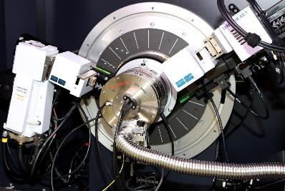
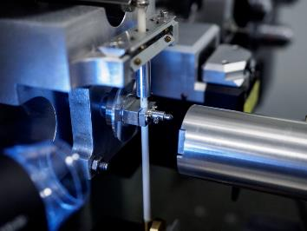
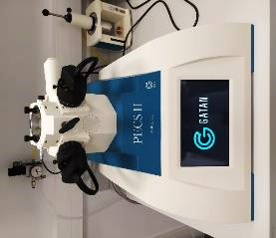
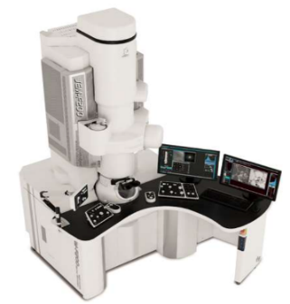
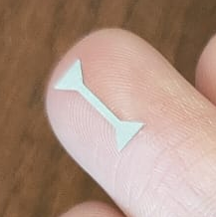
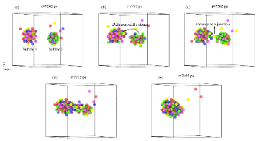
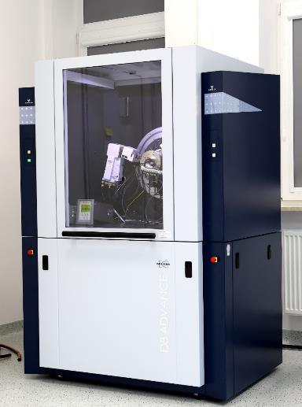
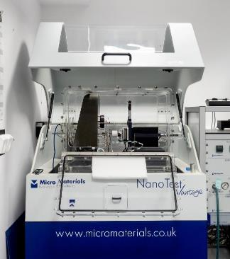
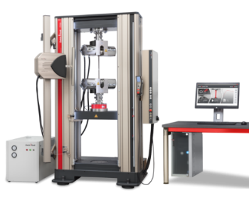
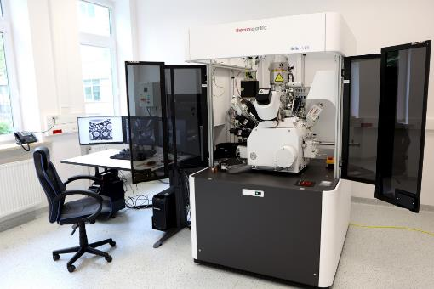
Concept
MODELLING
STRUCTURE
FUNCTIONAL PROPERTIES
Specialization –> hollistic approach to materials in harsch environments

Slide 7
Opportunities
We treat NOMATEN as a tool for initiation of broad cooperation network
Initiation of national and international cooperation programs
Building infrastructure and competencies that are complementary to „big players”
Preparation of grant proposals and support of grant implementation
Cooperation with industry and participation in large national projects (PPEJ)
Total value of grants: investments about 30 MEUR, research about 6 MEUR
Keyword and mandatory condition: SUSTAINABILITY

Slide 8
Future
Unknown.

Slide 9
Future
Unknown.
We have achieved most of our goals, the Center already employs about 50 people, we have modern equipment, we obtained 6 EU and 10 national grants (12 new EU proposals are being submitted), we cooperate with the best centers in the world (Harvard, MIT, CNRS, INL, CEA, VTT, JRC, JAEA, KAERI, …) and industry (17 contracts in 2024), this year our young employees will defend 5 doctoral theses.

Slide 10
Future
Unknown.
We have achieved most of our goals, the Center already employs about 50 people, we have modern equipment, we obtained 6 EU and 10 national grants (12 new EU proposals are being submitted), we cooperate with the best centers in the world (Harvard, MIT, CNRS, INL, CEA, VTT, JRC, JAEA, KAERI, …) and industry (17 contracts in 2024), this year our young employees will defend 5 doctoral theses.
Despite the 50% probability of success in acquiring national and European projects, securing the Center's finances, including maintaining the equipment, is almost impossible. There are no dedicated mechanisms for financing such centers. In my opinion, the main problem is financing of research mainly through 3-year grants at the expense of long-term, goal-oriented national development programs such as the HTGR project.

Slide 11


Thank you for your attention

